Slide 1

L-42 ASTM D7452

Slide 2
L-37
Measures the anti-scoring properties of hypoid gear oils by subjecting the axle to high speed and shock loading, characterized by sudden accelerations and decelerations.
Copyright© Performance Review Institute
2

Slide 3
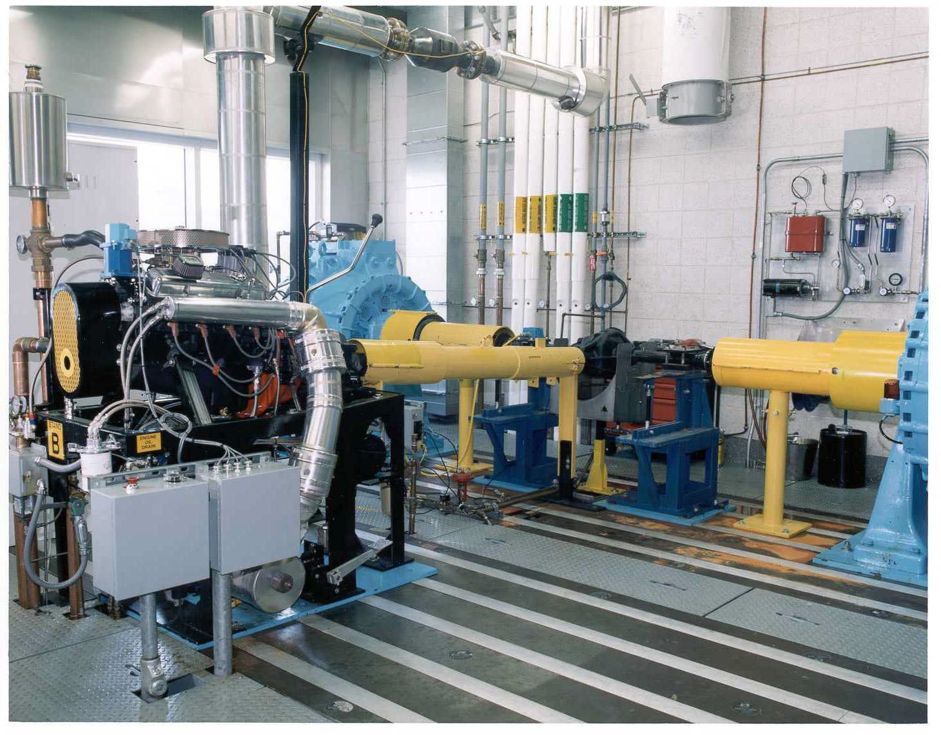
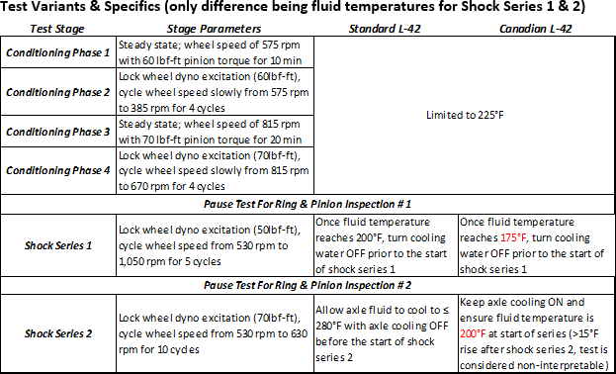
L-42 SHOCK BUMP TEST
Same rig as L-37
Dana 44 axle (4.09:1)
In line torque meter
Midwest 3232 2000 hp dynos
Procedure:
New L-42 test method using an electrical dyno vs. fired engine is being evaluated.
Copyright© Performance Review Institute
3

Slide 4
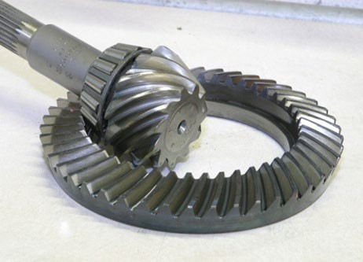
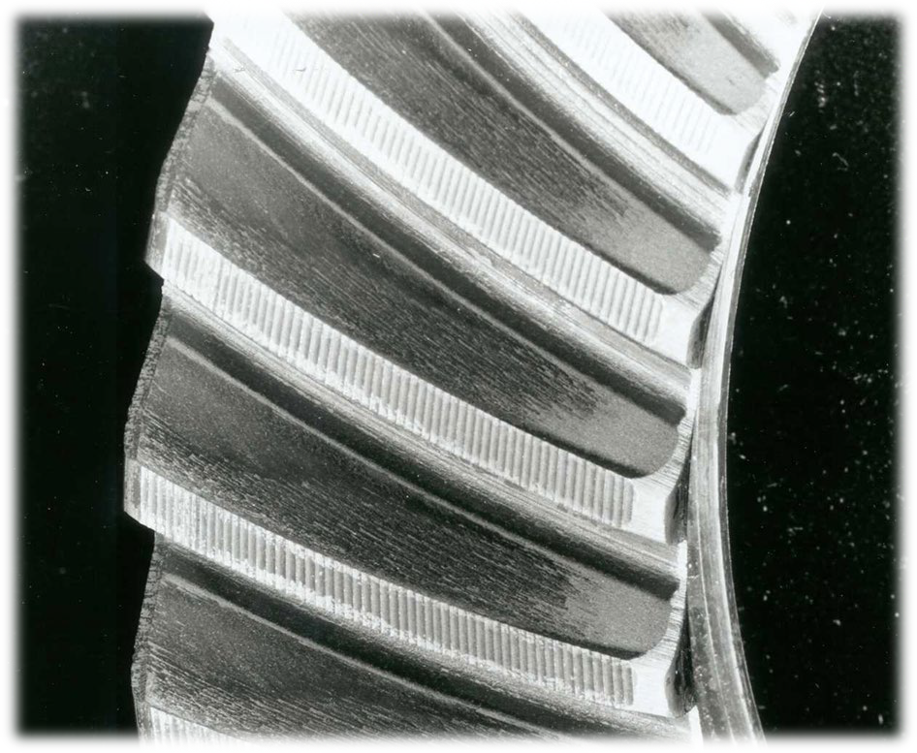

LEVELS OF DISTRESS
If the gear oil has insufficient extreme pressure performance, typically from sulfur chemistry, then scoring distress can occur on the ring and pinion, typically on the coast side.
CRC Manual #21 defines Scoring as: “The displacement of metal by local momentary welding from the gear tooth, in the development of a matte or frosted, dull surface.”

Slide 5
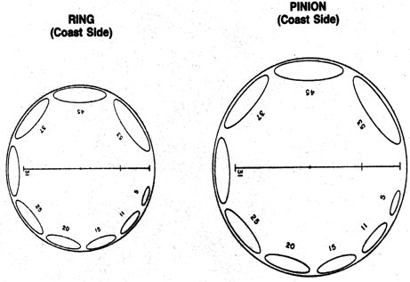
L-42 RATINGS
Certified raters will use rating aids to define the % scoring on the drive
and coast sides of the ring and pinion.
SAE J2360 requirements:
0% scoring on drive side of both ring and pinion
% scoring on the pinion coast side must be equal to or greater than
% scoring on ring coast side
The ring and pinion coast side % scoring must be equal to or less than the average % scoring for the last 3 passing reference runs
Copyright© Performance Review Institute
5

Slide 6
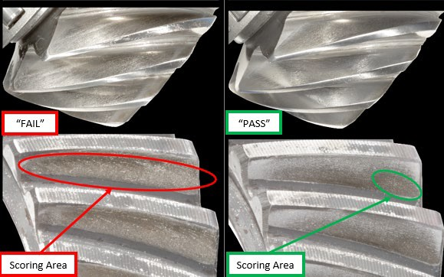
L-42 RATINGS
Copyright© Performance Review Institute
6

Slide 7
L-42 RIG CALIBRATION
Test labs must complete a calibration sequence after every 20 non-reference L-42 tests or after 3 months since the last acceptable reference oil test sequence.
  Reference oil obtained from Test Monitoring Center (TMC).
  Conduct 3 passing oil tests that fall within the TMC limits.
  Every 6 months or after 4 calibration sequences a discrimination or “fail” oil must be completed along with the 3 passing oil tests.
  Test reports are submitted to TMC to ensure they are consistent with industry standards before rig is deemed calibrated.
L-42 can be conducted at Southwest Research Institute or Intertek AR
  The Lubrizol Corporation and Afton Chemical Corporation have capability.
Copyright Performance Review Institute
7
©

