Slide 1

L-60-1 ASTM D5704
THERMAL AND OXIDATION STABILITY TEST

Slide 2
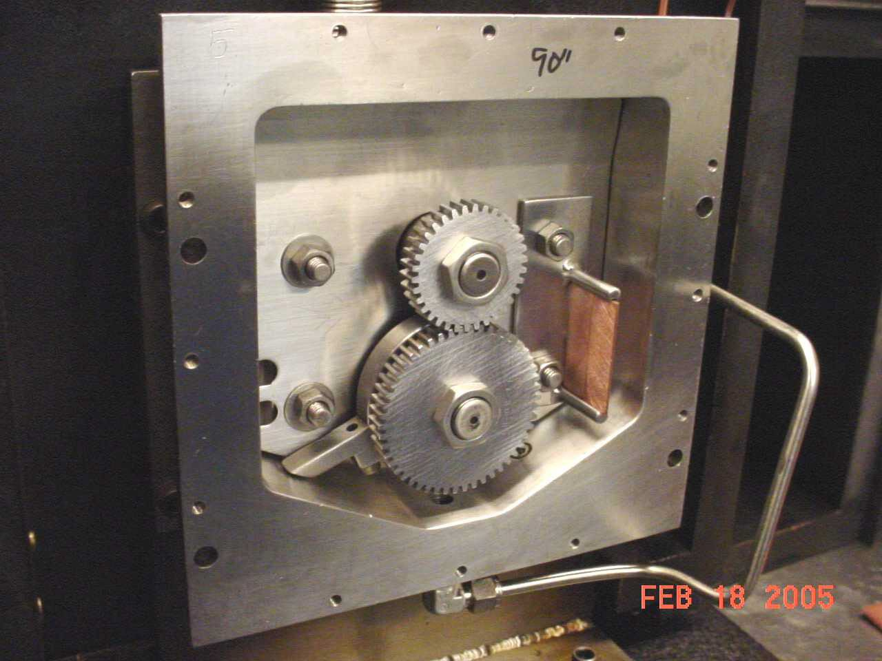
L-60-1
Gear oil is placed in a special gear case with two spur gears and copper catalyst strip to accelerate oxidation.
Test is run for 50 hours at 325°F with gears being driven at 1,750 rpm under a load of 128 Watts with air bubbled through the oil @ 1.1 L/hr.
The used oil is submitted for
  KV100°C
  Pentane and toluene insolubles
The gears are wiped with a cloth and rated front and back using rating aids.
  Varnish color rating scale
  Carbon rating aid
  Sludge scale
  Sludge depth gauge
Copyright© Performance Review Institute
2

Slide 3
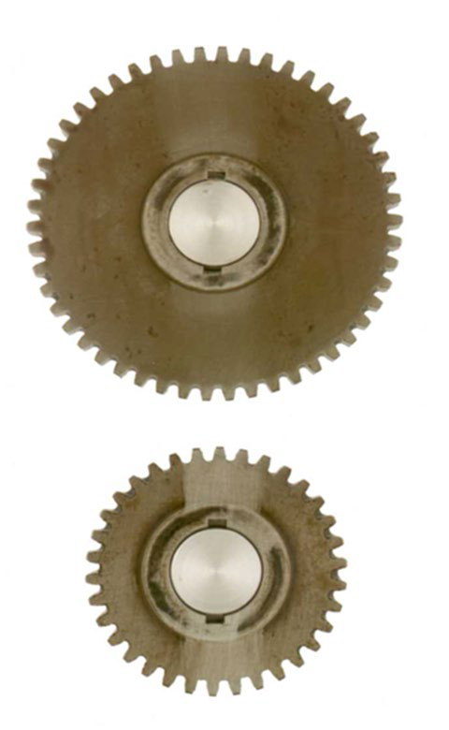
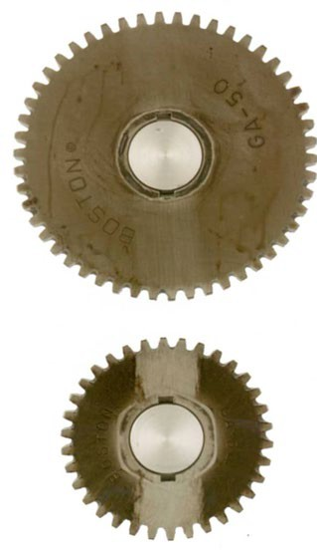
L-60-1 GEAR RATING
Back
Front
Copyright© Perfor
mance Review Institute
3

Slide 4
SAE J2360 L-60-1 REQUIREMENTS
If the gear oil has insufficient antioxidants and dispersancy for clean-gear chemistry, then carbon/varnish and sludge can form on the gears.
SAE J2360 limits:
Visc increase at 100°C Pentane insolubles Toluene insolubles Carbon/Varnish rating
100% max.
3.0% max.
2.0% max.
7.5 min.
Sludge rating 9.4 min. Report wt. loss
Report copper catalyst wt. loss

Slide 5
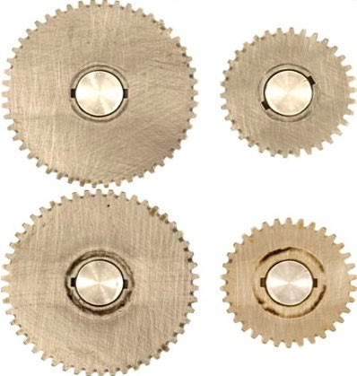
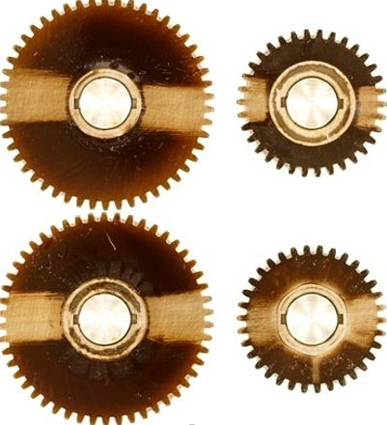
L-60-1 PASSING VS FAILING GEARS
Gears fail J2360 but pass API GL-5
Gears pass J2360 and API GL-5
Copyright© Performance Review Institute
5

Slide 6
L-60-1 RIG CALIBRATION
Test labs must complete a calibration run every 10 tests or 3 months, whichever comes first.
  Reference oil obtained from Test Monitoring Center (TMC)
  Test reports are submitted to TMC to ensure they are consistent with industry standards before rig is deemed calibrated.
L-60-1 can be conducted at Southwest Research Institute or Intertek AR
  The Lubrizol Corporation and Afton Chemical Corporation have capabilities.
Copyright© Performance Review Institute
6

