Slide 1

AS13100
Auditor Training Guide
April 2022

Slide 2
Contents
The training includes the standard, Audit checklist, and supporting materials
AS13100 Summary
Reference Materials
Standard Review
PRI Registrar Offering
PRI Modified Audit Checklist
RMS activities will be used for delivery of service

Slide 3
AS13100 Summary

Slide 4
What is AS13100?
AS13100 is an AQMS standard developed by AESQ and published March 2021 by SAE for aerospace engine component manufacturers.
Standard includes AS9100 requirements with additional requirements such as PPAP, APQP, MSA, DPRV, and other quality practices.
AESQ has developed and provided quality support materials to help suppliers understand and implement AS13100 requirements. (Referenced within).
SAE Training provides a 10 hour course and a Quality Foundations course
Suppliers are required to demonstrate conformance by January 2023
Evidence of conformity will be completed audit checklist (AESQ developed)
PRI Registrar will provide audits against the checklist to help suppliers demonstrate conformance
This is not a certification program, so we are offering it as a special audit

Slide 5
Reference Materials

Slide 6
AESQ Quality Support materials
AESQ has developed and provided quality supporting materials for users of AS13100 to understand and implement the requirements. They include:
  8D Problem Solving Method
    8D Interactive Tool
    Supplier 8D Reporting Template
    8D Word Form
    8D Template (Excel)
    8D Template (Powerpoint)
  Alternate Inspection Frequency Plans
  Advanced Product Quality Planning (APQP) and Production Part Approval Process (PPAP)
  Defect Prevention Quality Tools (APQP PPAP)
    AS13004 Template and Examples
    DFMEA Template
  Design Work
  First Article Inspection
  Human Factors
    Appendix 2 Investigation Human Factor Checklist
    Appendix 3 Maintenance Error Decision Aid (MEDA)

Slide 7
AESQ Quality Support materials Continued
  Measurement Systems Analysis
  Quality Audit Requirements
    Appendix B Risk Assessment
    Appendix C Quality System Audit
    Appendix D Production Process Audit
    Appendix E Management Review
    Appendix F Annual Audit Report
  Rework and Production Repair of Non-Conforming Products
  Sub Tier Management
  Process Control Methods
    Assessment
    Training Syllabus
    Guidance Material
    Process Capability Plan
  Compliance Assessment Form
Note: these documents are also embedded in this training guide for related reference.

Slide 8


Standard Review

Slide 9
Chapter A
4 – Context of the Organisation

Slide 10
4.3.2 Deliverable Software
Organizations whose products are deliverable software, or contain deliverable software, shall comply with 9115 when planning and evaluating the software design, development, or management activities of the organization.
Does the organization have and customer or regulatory requirements regarding deliverable software?
Does the organization have access to AS9115 and is this being followed for software design activities?

Slide 11
4.3.4 Access to OASIS and NADCAP Databases
The organization shall provide access to relevant data within Online Aerospace Supplier Information System (OASIS) and Nadcap databases (e.g., registration documentation, certification, audit reports and findings, corrective actions) to its customers.
Can the organization demonstrate active access to the OASIS and or NADACP database and navigate them effectively?

Slide 12
4.3.5 Compliance Matrix & Scope
The organization shall conduct an AS13100 Compliance self-assessment to ensure that the scope of its Management System includes the full scope of this standard, see RM13009 for recommendations on how to complete a compliance self-assessment.
Does the organization have a completed Compliance Matrix and Defined Scope that reflects the organization's ability to meet the requirements of the AS13100?
Has the organization developed an action plan to address any gaps identified during the self-assessment?

Slide 13
4.4.3 Quality Management System and its processes – Supplemental Processes: Human Factors
The organization’s Quality Management System shall include Management of Human Factors in its processes (5.1.1.1) including:
Training of employees.
An open reporting culture, encouraging the sharing of mistakes without fear of retribution.
Considering Human Factors in investigations.
Considering Human Factors in the reporting of performance and identifying improvement plans.
Human Factors should be an integrated part of product and service design, manufacturing/assembly, and product servicing.
NOTE: For details on the deployment of Human Factors within the organization, see RM13010.
Can the organization show evidence that their Quality Management System includes Management of Human Factors in its processes including training of employees?
Do they have an open reporting culture, encouraging the sharing of mistakes without fear of retribution?

Slide 14
Chapter A
5 – Leadership

Slide 15
5.1.1.1 Leadership & Commitment – Supplemental Requirements
Top Management shall demonstrate a commitment to Human Factors in accordance with 4.4.3 and 7.3.1, see RM13010.
Can the organizations show Top Management evidence that demonstrates their commitment to Human Factors in accordance with 4.4.3 and 7.3.1?

Slide 16
5.2.1.1 Establishing the Quality Policy – Supplemental Requirements
The organization shall have a policy that includes Human Factors which promotes:
Open Reporting.
Continually improving the maturity of Human Factor deployment within the organization.
Does the organization have a policy that includes Human Factors which promotes:
  Open Reporting
  Continually improving the maturity of Human Factor deployment within the organization

Slide 17
5.3.1 Organizational Roles, Responsibilities and Authorities – Supplemental Requirements
Personnel responsible for conformity to product requirements shall have the authority to stop and correct quality problems.
Where the process design prevents immediate shutdown upon detection of a quality problem, then the product or service shall be contained so that it is prevented from being delivered to the customer.
Where production is run across different shifts there shall be personnel identified that are accountable for ensuring conformity to product requirements.
Can the organization provide evidence that personnel responsible for conformity to product requirements have the authority to stop and correct quality problems?
Where the process design prevents immediate shutdown upon detection of a quality problem, does the organization have provisions for containment of the product or service to prevent product from being delivered to the customer. Additionally, where production works multiple shifts is there personnel identified as accountable for ensuring conformity to product requirements.

Slide 18
Chapter A
6 – Planning

Slide 19
6.1.3 Actions to Address Risks and Opportunities – Supplemental Requirements
The organization shall implement a risk management process, e.g., ISO 31000, across their organization and put appropriate governance in place such that they:
Carry out a robust assessment of risks, in particular those that could threaten future performance, and detail these in a risk register.
Carry out a review of the effectiveness of their risk management system (including internal controls), at least annually.
Ensure appropriate risk mitigation is in place (including internal controls) that is appropriate to the risks identified.
The organization shall establish a crisis management and business continuity plan and inform its customer purchasing representative within 3 working days of becoming aware of an issue regarding the following:
Major incidents affecting the organization that impact the organizations' ability to meet customer commitments.
Risks that could impact the continuity of the organization’s business/operations, particularly single points of failure.
Changes to third party or other party QMS Certification including, lapse/withdrawal/major audit findings to the relevant customer.
Change of the nominated quality representative, (usually the most senior Quality Leader within the organization).
Significant change to the Quality Management System.
Change in ownership or discontinuation of business activities.
Significant issues of breaches of Information Technology (IT) security systems (Cyber Security).
Risks with the supply of substances used in the production or physical make-up of products, due to laws and regulations concerning the control or use of such substances that may be published from time-to-time.

Slide 20
6.1.3 Continued
Does the organization have a risk management process, e.g., ISO 31000, implemented across their organization and have appropriate governance in place?
Do the personnel responsible for Risk Management; Perform a robust assessment of risks, specifically risks that could have an impact on future performance, and detail them on a risk register. Ensure appropriate risk mitigation is in place (including internal controls) that is appropriate to the risks identified. Conduct a review of the effectiveness of their risk management system including internal controls, at least annually.
Does the organization have a documented crisis management and business continuity plan and provisions to inform its customer purchasing representative within 3 working days of becoming aware of an issue regarding the following:
  Major incidents affecting the organization that impact the organizations’ ability to meet customer commitments.
  Risks that could impact the continuity of the organization’s business/operations, particularly single points of failure
  Changes to third party or other party QMS Certification including, lapse/withdrawal/major audit findings to the relevant customer
  Change of the nominated quality representative, (usually the most senior Quality Leader within the organization) or any Significant change to the Quality Management System
  Change in ownership or discontinuation of business activities.
  Significant issues of breaches of Information Technology (IT) security systems (Cyber Security).
  Risks with the supply of substances used in the production or physical make-up of products, due to laws and regulations concerning the control or use of such substances that may be published periodically.

Slide 21
Chapter A
7 – Support

Slide 22
7.1.5.1.1 Measurement Systems Analysis – Supplemental Requirements
MSA guidance is available, see RM13003 and may be applied in conjunction with the requirements defined in this paragraph. The customer shall approve equivalent methods, see RM13003.
The organization shall have access to a practitioner who has appropriate experience and can demonstrate competence in MSA.
The organization shall assess when to apply MSA in accordance with Table 3.
All MSA studies shall be planned to ensure they are conducted under production conditions.
The analysis, evaluation and acceptability of study results shall be compliant with this standard’s requirements, and improvement actions are implemented where unsatisfactory results are obtained.
The organization shall evaluate the need for MSA study on every characteristic and ensure all key characteristics have MSA studies performed on them.
MSA requirements on minor characteristics, shall be evaluated as agreed with the organization responsible for the Design or the organization may consider tight tolerances, quality escapes, design and process risk assessments, and specific customer requirements.
The organization shall document the rationale where it has decided MSA studies are not required. This should happen within the PFMEA.

Slide 23
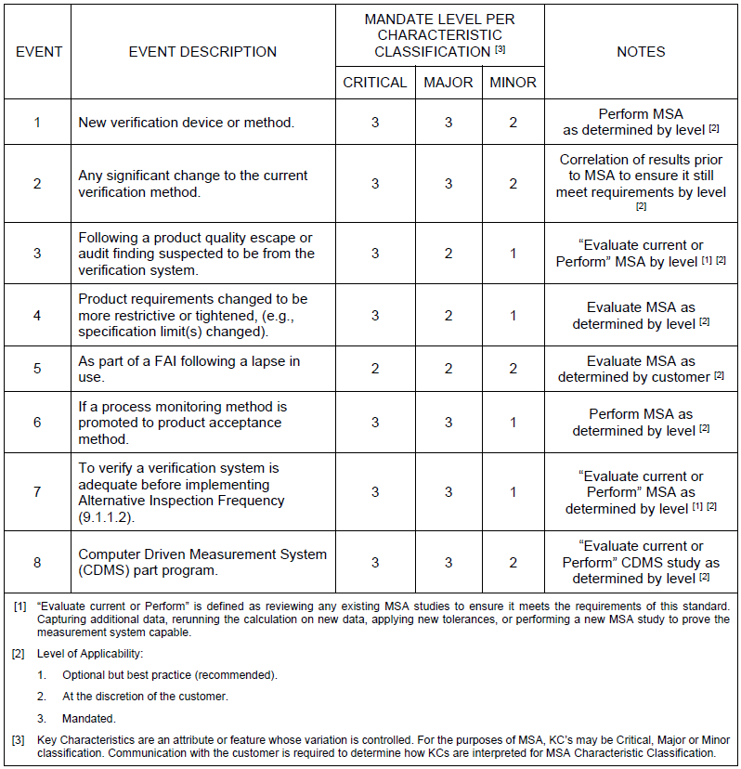
7.1.5.1.1 Continued
For information on when and how to apply MSA studies, see Table 3, which is based on characteristic classification (Critical Feature, Major Feature, and Minor Feature) and is applied in three levels of mandate:
Level 1 - Optional but best practice (recommended).
Level 2 - At the discretion of the customer.
Level 3 - Mandated.

Slide 24
7.1.5.1.1 Continued
Does the organization have access to a practitioner with appropriate experience and can demonstrate competence in MSA?
Does the organization document the rationale where it has decided MSA studies are not required in their PFMEA?
Are MSA studies planned to ensure they are conducted under production conditions. Is the analysis, evaluation and acceptability of study results compliant with this standard’s requirements?
Are improvement actions implemented when unsatisfactory results are obtained?
Does the organization evaluate the need for MSA study on every characteristic and ensure all key characteristics have MSA studies performed on them? Are MSA requirements on minor characteristics, evaluated as agreed to with the organization responsible for the Design? If not, do they have evidence that they consider tight tolerances, quality escapes, design and process risk assessments, and specific customer requirements?

Slide 25
7.1.5.1.2 Conduct MSA as planned
The following MSA checks aligned to industry-recognized techniques shall be performed:
Ensure that the personnel nominated to perform product verification activities are trained and competent in the use of the monitoring/measuring equipment.
Ensure MSA tests align to industry-recognized techniques, see RM13003.
Ensure when a Product definition contains Constraint Requirements, they are included in the measurement study.
Ensure production parts, representative parts, or artefacts that represent the manufacturing process, tolerances, and dimensions are used.
Ensure personnel, resources, and methods replicate the conditions in the production process and during the trial personnel do not have visibility of study results.
Ensure study results show statistical stability.
Has the organization met all the requirements outlined in RM 13003 for Measurement System analysis?
  Did the organization utilize AS13100 Table 3 when determining "when to apply measurement capability assessment”?
  Does the organization have evidence of a competent person performing MSA, if required?
  If MSA is not required is the documented in the organizations PFMEA?

Slide 26
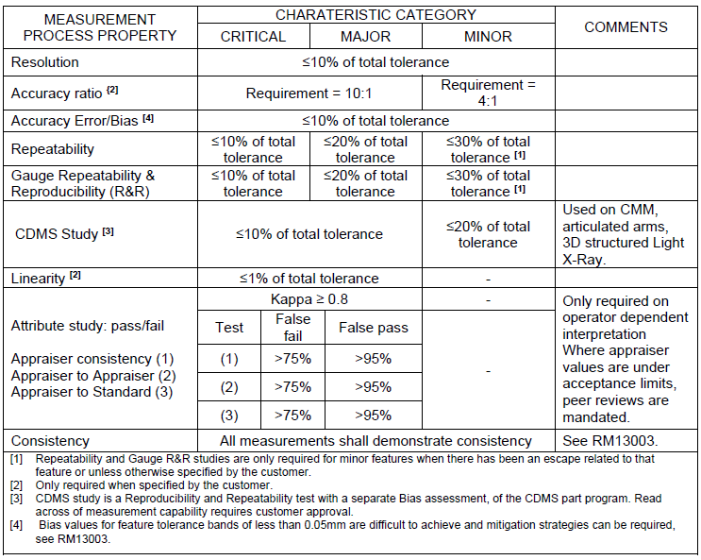
7.1.5.1.3 Confirm MSA Acceptance
The Organization shall document suitable evidence to demonstrate measurement system capability for the planned characteristic classification category against the tests required for the MSA acceptance limits, see Table 4.

Slide 27
7.1.5.1.3 Continued
Has any MSA been performed, and the associated output been reviewed and approved by the customer /design authority?

Slide 28
7.1.5.1.4 Agree Improvement Actions for MSA
The organization shall define and implement actions to resolve gaps in measurement system capability including mitigation actions to protect the customer.
Has the organization documented and received approval from the customer for the resolution and mitigation of any gaps in their measurement system capability?

Slide 29
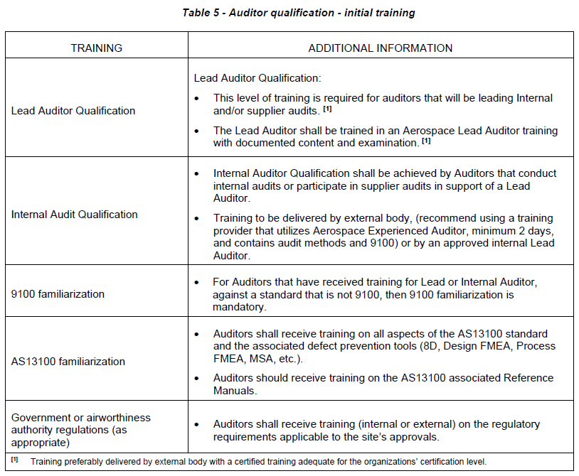
7.2.2 Auditor Competence
The organization shall have a process to set and maintain the qualifications for all Auditors as defined by Table 5, Table 6, and Table 7. A list of qualified Auditors shall be maintained.

Slide 30
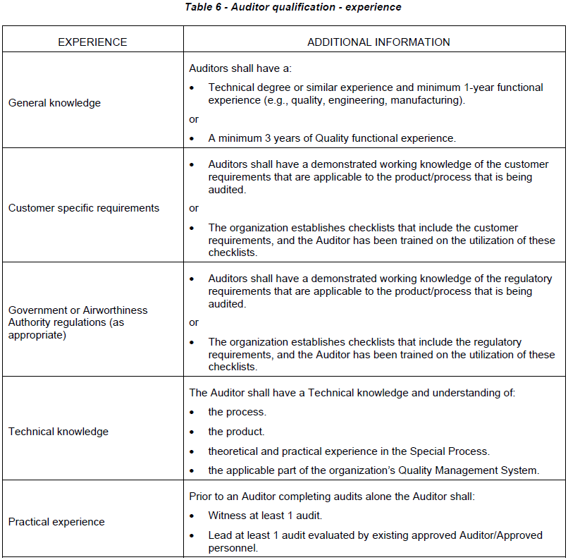
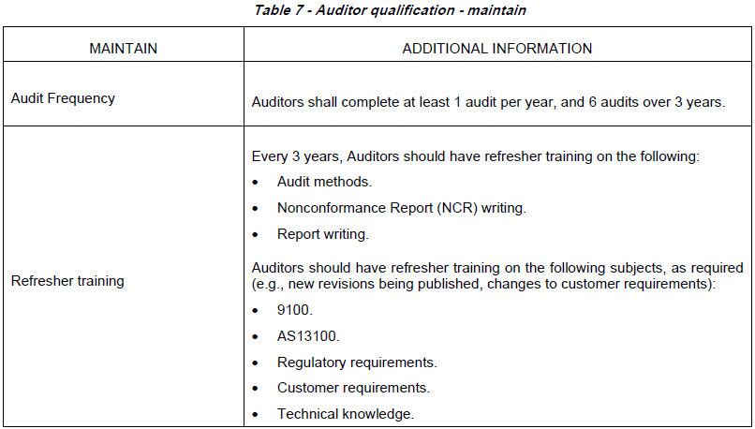
7.2.2 Auditor Competence Continued

Slide 31
7.2.2 Auditor Competence Continued
Does the organizations training program include the requirements for auditor training outlined in AS13100 Tables 5, 6 & 7?

Slide 32
7.2.3 Delegated Product Release Verification (DPRV) Representative Training
DPRV personnel shall be trained and certified in accordance with AS13001 Delegated Product Release Verification Training Requirements.
Can the organization provide verification that personnel have been trained and certified in accordance with the AS13100 Delegated Product Release Verification Training Requirements?

Slide 33
7.2.4 AESQ Quality Foundation Training
The organization shall ensure that Quality Leaders with responsibility for deploying the requirements of AS13100 within the organization are trained in the requirements of AS13100 and related Quality Management Standards through an AESQ approved AS13100 Requirements training course. This course is also recommended for functional leaders responsible for creating or managing processes that are impacted by AS13100 Requirements.
In addition, the organization’s Quality Leaders with responsibility for supporting the design, manufacturing, and assembly operations via AS13100 shall undergo training in the AESQ Quality Foundations Training course. This course is also recommended for design engineering, manufacturing engineering and operations roles.
Equivalent training that meets the AESQ AS13100 Requirements and Quality Foundations course syllabi shall be approved by the AESQ.
Can the organization provide evidence of AESQ approved Training for Quality Leaders?

Slide 34
7.5.2.1 Changes to Documented Information - Supplemental Requirements
When creating and updating documented information, the organization shall record, date and ensure traceability to a responsible person making the change (e.g., name, signature, stamp, electronic signature), with a permanent marking method and the original information being legible and retrievable after the change.
Documented Information such as records shall not be altered without proper traceable documented information permitting the alteration.
Documented information requiring submission or approval by the customer shall be written in English, unless otherwise specified by the customer.
Where documented information contains reference to units of measure then they are to be recorded in the same units of measure as defined on the Product Definition.
Does the organizations Document Management Process include provisions for making changes in accordance with AS13100?

Slide 35
7.5.3.3 Document Retrieval Timescales
The organization shall ensure that documented information (data) required for review is available for the customer, the customer’s customer, and/or Regulatory Agency within 3 working days of notification.
In the case of an onsite visit, actual documented information (data) shall be made available within 24 hours, unless the required documented information (data) is located offsite, then the organization needs to make every effort to retrieve the data as soon as possible, but no later than 3 working days.
The delivery of documented information (data) to the customer, etc., does not release the organization from any requirements herein with respect to that documented information (data) except as agreed to in writing by the customer, etc.
The organization shall create and retain comprehensive technical documented information of all the aspects that influenced the design throughout its development, e.g., alternative designs, key decisions, problems encountered and how they were resolved, considerations, trade-offs, design standards used.

Slide 36
7.5.3.4 Damage to records
The organization shall inform the customer immediately and confirm in writing when damage to documented information of the design and development output under their responsibility occurs or following termination of activity.
Does the organization have a process for customer notification for document damage and or destruction?

Slide 37
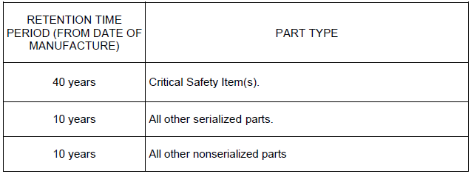
7.5.3.5 Document Retentions Periods – Supplemental Requirements
Unless otherwise specified by the customer documented information shall be retained from the date of manufacture for the time periods defined in Table 8.
If a contract is open, all documented information shall be retained. If the contract is closed, then the documented information (data) becomes a candidate for disposition in accordance with retention time period requirements. For questions related to this requirement, contact your assigned customer quality representative.
Does the organization have a documented requirements for record retention beyond customer requirements that aligns with Table 8?

Slide 38
7.5.3.5.1 Design Records Retention
Documented information (Design Records) shall be retained for End of Life of Product Operation plus (+) 10 Years, if not otherwise required by the customer.
See AS13100 Requirement for further definition
End of Life of Product Operation + 10 Years unless otherwise specified?

Slide 39
7.5.3.5.2 Radiographic Film Record Retention
Original nondestructive evaluation/testing process related records including, but not limited to, radiographic film must be maintained, in accordance with the retention period specified in Table 8, by the source responsible for the final quality certification of the product, unless the source performing the nondestructive evaluation/testing activity is shipping direct to the customer on behalf of supplier.
See AS13100 Requirement for further definition
Additionally, as per table 8 – retention periods for retained documented information.

Slide 40
7.5.3.5.3 Program Code Record Retention
Where calculated data required to be retained for statutory or regulatory reasons is the output of a computer program, there is no requirement to keep the program code originally used, however, the original input data and methods shall be retained to enable recalculation.
See AS13100 Requirement for further definition
Additionally, as per table 8 – retention periods for retained documented information.

Slide 41
Chapter A
8 – Operation

Slide 42
8.1.3.1 Product Safety – Supplemental Requirements
The organization shall report to the Customer, Original Equipment Manufacturer (OEM), or Engine Type Certificate Holder within 24 hours of verification, anything that can affect the product’s safe and reliable operation identified at any stage in the product’s life.
The OEM or Engine Type Certificate Holder is responsible for making the final judgment on whether there is an actual risk to safe and reliable operation.
Does the organization have provisions in place for 24-hour reporting of any potential product safety issues/concerns?

Slide 43
8.1.4.1 Prevention of Counterfeit Parts – Supplemental Requirements
The organization shall plan, implement, and control counterfeit part prevention processes in accordance with AS6174 or AS5553, as applicable.
The organization shall ensure that the counterfeit part prevention process includes a mechanism for reporting counterfeit parts to the customer purchasing representative within 24 hours of it being confirmed.
Does the organization’s counterfeit parts prevention process meet AS6174 or AS5553 requirements as applicable?
Does the organization have provisions in place for 24-hour reporting for discovery/identification of counterfeit parts?

Slide 44
8.2.1.1 Customer Communication - Supplemental Requirements
The organization shall only accept privileges, agreements, and instructions in writing (e.g., Interface Documents, purchase order, purchase order supplements/amendments).
Verbal agreements and instructions shall not be construed as customer approval or authorization.
The organization shall agree with the customer the method of formal communication (e.g., for approval, authorization, agreement) to be used and the applicable traceability requirements such as proforma, coordination memorandum, etc.
The organization shall provide access to data within OASIS and Nadcap databases (e.g., registration documentation, certification, audit reports and findings, corrective actions) to its customers.
The organization shall notify its customer if there are any changes to certification, registration, or accreditation within 3 working days of the change.
See AS13100 Requirement for further definition

Slide 45
8.2.2.1 Determining the Requirements for Products and Services – Supplemental Requirements
The organization shall ensure that it uses the latest revisions of the customer specific procedures/forms/templates where specified by and agreed with the customer.
Provide evidence that shows operational risks (e.g., new technology, ability and capacity to provide, short delivery time frame) are identified during contract review.
Does the organization have a method for revision control for customer procedures forms and templates?

Slide 46
8.2.3.3 Engineering Specifications and Certification Compliance – Supplemental Requirements
The organization shall have a documented process describing the review, distribution and implementation of all customer engineering standards/specifications and related revisions based on customer schedules, as required.
The organization shall comply with customer requirements for designation, approval documentation and control of KCs.
Has the organization clearly identified the customers Key Characteristics as Critical/Major/Minor?

Slide 47
8.3.1.1 Design & Development of Products and Services – Supplemental Requirements
The organization shall have a documented process that describes the Design and Development Process.
The Design and Development Process shall comply with applicable elements of the Advanced Product Quality Planning (APQP) and Production Part Approval Process (PPAP) as defined by 9145 and AS13100 - Chapter B.
The organization shall have an appointed person or equivalent, who is responsible for coordination of all design and development activities and who can act as a single point of contact for the customer.
The organization shall update and maintain the traceability of customer technical requirements, transfer them into the technical specifications of their product and manage the data validation and verification of these requirements.
The organization shall maintain an active list of authorized design approvers, as applicable to the organization’s scope of work.
The organization, when applicable shall have a documented system to handle formal Technical Delegation, see RM13008.
Does the organization have documented Design & Development process?
Does this process have documented milestones based on scope/scale /complexity/risk and does it include Design Reviews?
Does this process comply with both the Advanced Product Quality Planning (APQP) and Production Part Approval Process (PPAP) as defined by 9145 and AS13100 - Chapter B.

Slide 48
8.3.2.1 Design & Development Planning – Supplemental Requirements
Design and Development Planning - Supplemental Requirements
The organization shall ensure that design and development planning include all relevant stakeholders within the organization and, as appropriate, its supply chain. Examples of areas for using such a multidisciplinary approach include, but not limited to the following:
Project management, e.g., APQP.
Product and manufacturing process design activities, e.g., Design for Manufacture (DFM) and Design for Assembly (DFA).
Development and review of Design FMEA including actions to reduce potential risks.
Has the organization identified and confirmed all relevant stakeholders?

Slide 49
8.3.2.2 Design & Development associated dependencies
The organization shall identify any associated dependencies needed for the successful progression of the design and development activity, e.g., where the organization needs information from the customer and include those milestone dates in the design and development plan. The organization is required to formally communicate those milestone dates to the customer for acceptance.
Does the organization’s design and development planning include all relevant stakeholders within the organization and, as appropriate, its supply chain? i.e. design, manufacturing, engineering, quality, production, purchasing, customer both internal and external, supplier(s), maintenance, or any other appropriate functions."
Acceptable examples can include but are not limited to: APQP, Design for Manufacturing (DFM) and or Design for Assembly (DFA), Design FMEA (DFMEA) and actions identified to reduce/eliminate risks.

Slide 50
8.3.2.3 Design Review Planning
The organization shall configure and plan Design Reviews appropriate to the project considering magnitude, complexity, novelty, risk, etc., (8.3.4.3) and include those milestone dates in the design and development plan.
Does the organization develop, conduct and document design reviews with approvals from any "required" stakeholders identified in 8.3.2.2

Slide 51
8.3.3.1 Design and Development Inputs – Supplemental Requirements
In addition to the Design and Development Input requirements defined in 8.3.3, the following supplemental requirements shall be identified and reviewed, as applicable:
Safety requirements, e.g., safety assessment output, part classifications.
Customer requirements, e.g., project timescales, aftermarket strategy including component lives, service intervals.
Operational requirements, e.g., fluid dynamics, loads, speeds, operating environments, maneuvering characteristics, and gyroscopic loads.
Boundary and interface requirements.
Requirements for Identification, traceability, and packaging.
Consideration of design alternatives.
Embedded software requirements.
Lessons learned, design standards, and best practice.

Slide 52
8.3.3.1 Continued
Do the organizations Design & Development Inputs include the following as applicable?
  Safety requirements, e.g., safety assessment output, part classifications
  Customer requirements, e.g., project timescales, reliability /aftermarket strategy including component life and service intervals
  Operational requirements, e.g., thermo/fluid dynamics, loads, speeds, operating environments, maneuvering characteristics
  Boundary and interface requirements
  Requirements for Identification, traceability, handling, and packaging
  Consideration of potential design alternatives
  Embedded software requirements
  Lessons learned and best practice.

Slide 53
8.3.3.2 Design Risk Analysis
When APQP has been required by the customer the organization shall conduct Design FMEA on the product design, see AS13100 - Chapter C (21), and RM13004.
The organization shall retain documented information as evidence of the results of the Design FMEA.
Alternative approaches to Design FMEA can only be used with customer approval.
Does the organization have a process for and/or documented evidence of a Design FMEA when the customer requires APQP? If not, do they have customer approval for an alternative method?
Does the organizations process include the following as applicable:
  Key Quality Planning Tools
  Design FMEA
  Product Key Characteristics
  Process Flow Diagrams
  Process FMEA
  Process Key Characteristics
  Production Control Plan
  Measurement Systems Analysis
  Initial Capability Studies.

Slide 54
8.3.3.2.1 New Technology – Supplemental Requirements
Where the organization identifies a requirement for new or novel technologies associated with the design of the product, the organization shall conduct an appropriate risk assessment and identify mitigating actions.
The technical aspects of the risk assessment shall be available to the customer upon request.
Does the organization have a process for and/or documented evidence of a Design Risk Assessment/Analysis for any new or novel technologies included in the design?
Does the documentation include the technical risks and is this technical data available for the organization's review?

Slide 55
8.3.3.3 Foreign Object Damage (FOD) – Supplemental Requirements
The organization shall comply with the requirements of 9146 for FOD Prevention Programs and design for the prevention, detection and safe removal of foreign objects and contamination being trapped during manufacture, maintenance or repair in such features as, but not limited to, apertures, orifices, sharp bends, and corners.
Does the organizations FOD Program comply with/include the requirements of 9146 for FOD Prevention Programs and design for the prevention, detection and safe removal of foreign objects and contamination being trapped during manufacture, maintenance or repair in such features as, but not limited to, apertures, orifices, sharp bends, and corners?

Slide 56
8.3.4.2 Progressive Product Definition Release – Supplemental Requirements
The organization shall employ an appropriate, traceable, progressive Product Definition release process that enables formal advance information to be provided to stakeholder functions (e.g., manufacturing, external providers).
Product Definitions shall be associated with the correct approval status of the design data (either approved or nonapproved) by Aviation Authority or under their delegation.
Does the organization have a process or provisions for a traceable, progressive Product Definition release process that enables formal advance information to be provided to stakeholder functions (i.e. manufacturing, external providers customers etc.)?
Are all Product Definitions associated with the correct approval status of the design data (either approved or nonapproved) by Aviation Authority or under their delegation?

Slide 57
8.3.4.3 Design Reviews – Supplemental Requirements
The organization shall conduct or support Design Reviews in accordance with arrangements planned and agreed with the customer, (8.3.2.3), formally documenting the output from Design Reviews including action owners and timescales for closure, see RM13008.
The organization shall agree the applicability of each appropriate Design Review with the customer in relation to the scope of the design and agree with the customer the roles, accountabilities, responsibilities, deliverables, attendees, and agenda for each Design Review.
Does the organization have a process or provisions for conducting and/or support of Design Reviews agreed to and in accordance with the customer? Do these Design Reviews have documented approval from the customer in relation to the scope of the design and agree with the customer's the roles, accountability, responsibility, deliverables, attendees, and agenda requirements for each Design Review?
Is there formal documentation of Review output that includes but is not limited to, actions/owners/timelines and closure activities?

Slide 58
8.3.4.4 Design Verification and Product Validation – Supplemental Requirements
The organization shall create a verification strategy documenting the activities necessary to verify that the design outputs meet the design inputs (requirements) using established methods and techniques such as, but not limited to; analysis, compliance to standards, comparison to existing established designs, inspection, test, etc., and agree the verification strategy with the customer prior to commencement of any verification activity, see RM13008.
The organization shall agree with the customer the material property data to be used in the design and its source prior to launching any design verification activity that requires the input of material property data, e.g., analysis, modelling.
The organization shall identify and formally document the activities necessary to validate that the product operates as intended in accordance with the requirements and agree the validation strategy with the customer prior to commencement of any validation activity.

Slide 59
8.3.4.4 Continued
Does the organization have documented evidence of the following:
  Verification activities are conducted to ensure that the design and development outputs meet the input requirements.
  Validation activities are conducted to ensure that the resulting products or services meet the specifications/requirements for the specified application or intended use.
  Where tests are necessary for verification and validation, these tests are planned, controlled, reviewed and documented in similar ways Inspection
Do the verification Methods include: Analysis, Testing, Product Application/Similarity, In Service Data/ Experience?
Does the organization have a customer approved verification strategy documenting the activities necessary to verify that the design outputs meet the design inputs (requirements) using established methods and techniques such as, but not limited to; analysis, compliance to standards, comparison to existing established designs, inspection, test, etc., and an agreed to verification strategy with the customer prior to commencement of any verification activity? Does the organization have documented customer approval and agree with the customer the material property data to be used in the design and its source prior to launching any design verification activity that requires the input of material property data, e.g., analysis, modelling etc.?
Has the organization identified and formally document the activities necessary to validate that the product operates as intended in accordance with the requirements and agree to and document the validation strategy with the customer prior to commencement of any validation activity?

Slide 60
8.3.4.5 Design for X – Supplemental Requirements
Design for ‘X’ (DfX) - Supplemental Requirements
The organization shall utilize a multidisciplinary approach to optimize the design relative to criteria such as:
Manufacturing capability (Design for Manufacture).
Ease of assembly/strip (Design for Assembly).
Cost (Design for Cost).
Weight.
Aftermarket including customer overhaul strategy, product lifing, repair capability (Design for Service).
Other design drivers and threats including accounting for variability and uncertainty, e.g., robust design, 6-sigma.
Utilize DfX as a tool for a multidisciplinary approach to optimize the design, see RM13008.

Slide 61
8.3.4.5 Continued
Does the organization utilize a multidisciplinary approach to optimize the design relative to criteria such as:
  Manufacturing capability (Design for Manufacture)
  Ease of assembly/strip (Design for Assembly)
  Cost (Design for Cost)
  Weight
  Aftermarket including customer overhaul strategy, product lifting, repair capability (Design for Service)
  Other design drivers and threats including accounting for variability and uncertainty, e.g., robust design, 6-sigma
Utilize DfX as a tool for a multidisciplinary approach to optimize the design?
Does the organization have access to and or working knowledge of RM 13008?

Slide 62
8.3.4.6 Failure Reporting – Supplemental Requirements
The organization’s quality procedures shall include failure reporting, analysis, and corrective action as set out in 10.2.4, unless otherwise agreed with the customer.
Does the organization’s quality procedures include failure reporting, analysis, and corrective action as set out in 10.2.4, unless otherwise agreed to and documented with the customer?

Slide 63
8.3.5.1 Design Rationale – Supplemental Requirements
The organization shall create and retain comprehensive technical documented information of all the aspects that influenced the design throughout its development, e.g., alternative designs, key decisions, problems encountered and how they were resolved, considerations, trade-offs, design standards used.
Does the organization have objective evidence supporting the creation and retention of comprehensive technical documented information of all the aspects that influenced the design throughout its development, e.g., alternative designs, key decisions, problems encountered and how they were resolved, considerations, trade-offs, design standards used?

Slide 64
8.3.5.2 Critical Items and Key Characteristics – Supplemental Requirements
The organization shall document CIs and KCs and:
Ensure they are agreed with the customer, if required.
Comply with any customer requirements for symbols and notations.
Ensure KCs are identified on relevant documentation as agreed by the customer, see RM13008 for details on feature unique identification.
Does the organization have documented CIs and KCs and:
  Ensure they are agreed with the customer, if required?
  Comply with any customer requirements for symbols and notations.
  Ensure KCs are identified on relevant documentation as agreed by the customer.

Slide 65
8.3.5.3 Design and Development Outputs – Supplemental Requirements
The product design outputs [commonly known as the Design Technical Data Package (DTDP)] shall be agreed with the customer, see RM13008.
The organization shall ensure that contents of the DTDP are independently reviewed by suitably qualified individuals other than the authors.
Does the organization have documented product design outputs [ Design Technical Data Package (DTDP)] agreed with by the customer and do they ensure that contents of the DTDP are independently reviewed by suitably qualified individuals other than the authors and have documented evidence to support this?

Slide 66
8.3.5.4 Product End of Life – Supplemental Requirements
The organization shall, if applicable, define and document appropriate procedures and instructions for the disposal of “End of Life” products that they have designed and provide this information to the customer for inclusion in the applicable maintenance manual. Including giving consideration to:
Prevention of unauthorized reuse.
Minimization of environmental impact.
Compliance with national or international Health, Safety, and Environmental regulations.
Compliance with any national security regulations.
Safeguarding of customer intellectual property.
The organization shall agree on the disposal procedures with the customer.

Slide 67
8.3.5.4 Continued
Does the organization if applicable, define and document appropriate procedures and instructions for the disposal of “End of Life” products that they have designed and provide this information to the customer for inclusion in the applicable maintenance manual?
Does the organization have evidence of consideration to:
  Prevention of unauthorized reuse
  Minimization of environmental impact
  Compliance with national or international Health, Safety, and Environmental regulations
  Compliance with any national security regulations
  Safeguarding of customer intellectual property
Does the organization have an agreed to and documented disposal procedures with the customer?

Slide 68
8.3.6.1 Design and Development Changes – Supplemental Requirements
The organization shall operate a Design Change process that complies with 9116 and any Customer specific requirements.
The customer shall approve all design changes unless formal delegation has been given to the organization.
The scope and level of authorization shall be defined within an agreed delegation document from the customer.
The organization shall issue Notice of Change (NOC) data using the customer’s own NOC proforma or alternative as agreed with customer.
The organization, when required by the customer shall have a system to ensure:
All Class I and Class II Design Changes are submitted to the customer for change approval, unless the customer has granted written authorization to proceed differently (if a Class I Design Change), or for classification approval (if a Class II Design Change).
Rejected design changes are not incorporated into the supplier’s drawing or into hardware shipped to the customer.
All requested design change documentation is retained on file (including accepted and rejected dispositions).

Slide 69
8.3.6.1 Continued
Does the organization have a Design Change process that complies with 9116 and any Customer specific requirements?
Does the organization have provisions for customer approval of all design changes unless formal delegation has been given to the organization? If so, has the scope and level of authorization been defined within an agreed delegation document from the customer? Does the organization have a process to issue a Notice of Change (NOC) data using the customer’s own NOC proforma or alternative as agreed with customer?
Does the organization, when required by the customer have a system to ensure: All Class I and Class II Design Changes are submitted to the customer for change approval, unless the customer has granted written authorization to proceed differently (if a Class I Design Change), or for classification approval (if a Class II Design Change). Rejected design changes are not incorporated into the supplier’s drawing or into hardware shipped to the customer. All requested design change documentation is retained on file (including accepted and rejected dispositions).

Slide 70
8.4.1.2 Supplier Evaluation – Supplemental Requirements
Prior to supplier approval or issuance of a contract, the organization shall conduct an evaluation of the supplier.
The level of evaluation shall be determined by the Organization dependent on the risks, product or process criticality, and expectations.
Where there is significant risk identified, the organization shall perform an onsite evaluation.
The supplier evaluation shall include the following topics, as applicable:
Engineering and manufacturing capabilities - capability to manufacture the product to be contracted and control changes to design and processes.
Quality control capabilities - capability to meet quality requirements and deliver conforming product.
Purchasing, planning and capacity - ability to meet current and future requirements considering all resources as well as management of the supply chain.
Commercial, legal, and environmental - ability to meet commercial, regulatory business and customer requirements.

Slide 71
8.4.1.2 Continued
Has the organization conducted an evaluation of their suppliers prior to adding the supplier to the ASL and prior to issuance of a purchase order?
Note: The evaluation must include any risks related to the product. If significant risks are identified an on-site visit is required.

Slide 72
8.4.1.3 Supplier Selection – Supplemental Requirements
The organization shall document a risk mitigation plan to manage any identified risks resulting from the evaluation.
Is there a risk plan to address any identified risk(s)?

Slide 73
8.4.1.4 Supplier Register Maintenance – Supplemental Requirements
The organization shall have a documented process to assure that the QMS and other required certifications and approvals of the supplier remain valid.
When notified of any supplier change in quality leadership personnel or reporting structure, changes in scope, name, address, or approval status of QMS registrations, (see Table 2), applicable Production Organization holder approvals, and special process accreditations, the organization shall assess the impact and implement appropriate mitigation actions. This should include notification to the customer, as appropriate.
For 9100 certified Suppliers, the OASIS database, and the OASIS NG (Next Generation) Feedback Process shall be used.
Does organization have a documented procedure to ensure that suppliers certifications, scope and address remain valid and that customers are notified of any changes?

Slide 74
8.4.2.1 Type and Extent of Control – Supplemental Requirements
The Supplier’s QMS Certification shall be defined by the Organization Type and comply with Table 2.
The supplier shall establish and maintain an effective FOD prevention program that meets the requirements of 9146.
The supplier shall plan, implement, and control counterfeit part prevention processes in accordance with AS6174 or AS5553, as applicable.
The supplier shall ensure that the counterfeit part prevention process includes a mechanism for reporting counterfeit parts to the organization’s purchasing representative within 3 working days of it being confirmed.
The supplier shall notify the organization of any significant change in QMS or business operations.
The supplier shall comply with the organization’s specific requirements for control of work transfer.
The organization shall develop a risk analysis and mitigation plan to be implemented between the supplier and the organization to deal with any restrictions to right of access to the supplier's facility.

Slide 75
8.4.2.1 Continued
Is the Supplier’s QMS Certification defined by the Organization’s Type and does it comply with Table 2?
Is there an effective FOD prevention program and does it meet the requirements of 9146?
Does the supplier maintain, implement, and control counterfeit parts in accordance with AS6174 or AS5553, as applicable?
Does the organization’s external supplier ensure that the counterfeit part prevention process includes a mechanism for reporting counterfeit parts to the organization’s purchasing representative within 3 working days?
Does the supplier comply with the organization’s specific requirements for control of work transfer?
Note: A risk analysis and mitigation plan must be implemented between the supplier and the organization to deal with any restrictions to the right of access to the supplier’s facility.

Slide 76
8.4.2.3 Material and Special Process – Supplemental Requirements
Material and Special Process Test results shall reflect all requirements of the drawing and/or specification and conform to drawing and/or specification limits. Documented evidence of this conformity including listing of each material element or test result in the applicable test report.
The applicable test report shall be signed by a cognizant test laboratory person, clearly confirming which of the following is correct:
All tests and inspections have been performed and results meet the drawing and/or specification requirements, or
All tests and inspections have been performed and the results meet all the drawing and/or specification requirements, except _____________, which does not meet requirements, or
All tests and inspections have been performed and the results meet all drawing and/or specification requirements, except test(s) _______________, which was not performed in accordance with the drawing and/or specification requirements.

Slide 77
8.4.2.3 Continued
Is there documented evidence that all Material and Special Process Test results reflect the requirements of the drawing and/or specification and do they conform to drawing and/or specification limits?

Slide 78
8.4.2.4 Product Acceptance – Supplemental Requirements
When product acceptance authority media are used (e.g., stamps, electronic signatures, passwords), the supplier shall establish controls for the media appropriate to:
Avoid misuse.
Establish traceability to the authorized user.
Avoid duplication.
Align to responsibilities and authorities defined within the quality system.
Maintain good condition and legibility.
Does the organization ensure that the supplier has control over any acceptance authority media (stamps, electronic signatures etc.)?

Slide 79
8.4.2.5 Supplier Surveillance – Supplemental Requirements
The organization shall perform supplier risk assessments, which, at a minimum, include evaluation of results of supplier’s internal audits, supplier’s current quality performance, and part complexity.
The organization shall establish and execute appropriate surveillance methods to monitor supplier systems, processes, and products based on the risk evaluations.
When audit is used as a surveillance method, see RM13005 on how the audit can be conducted.
Does the organization perform risk assessments on their supplier’s systems, processes and products?
Note: Assessment may be through a review of internal audits, quality performance data and parts complexity – See RM13005

Slide 80
8.4.2.6 Supplier Performance Monitoring – Supplemental Requirements
Performance monitoring shall be performed and contain as a minimum Key Performance Indicators (KPIs) that can encompass Quality (e.g., disruptions, concessions, escapes) and delivery (e.g., schedule performance).
The organization shall provide the performance monitoring results to the supplier on a regular basis, as a minimum annually (e.g., posted on supplier portal, communicated regularly to the supplier).
Performance monitoring review frequency shall be increased for suppliers with unacceptable performance.
Where unacceptable performance at customer directed suppliers exists, the customer shall be notified.
When improvement actions have not been effective, the issue shall be escalated within the organization until resolved.
Is there a Supplier Performance Monitoring program to include at a minimum KPIs for Quality and Delivery? Are the suppliers provided with results of the data collected at least annually?
Note: If goals are not being met – improvement actions must be in place

Slide 81
8.4.3.1 Information for External Providers – Supplemental Requirements
The organization shall have a process to ensure that its suppliers understand contract requirements and flow the applicable specifications and requirements down the supply chain, see RM13007.
Does the organization have a process to ensure that suppliers understand contract requirements and flow the applicable specifications and requirements down the supply chain?
Note: See RM13007

Slide 82
8.5.1.1.1 Control of Equipment, Tools, and Software – Supplemental Requirements
A Software Quality Assurance program for all nondeliverable software shall be implemented, documented, and maintained.
The Software Quality Assurance program (documented process) shall include:
Responsibility and authority within the organization.
Identification of requirements.
Analysis of risks and criticality.
Coding - Ensure Coding Standards are defined and include, but not limited to:
  Software naming conventions (e.g., modules and executable software).
  Naming conventions including developmental and production file names.
  Header information with unique identifier and revision as a minimum.
Documented change history for modifications.
Verification and validation - The intent of the verification phase is to ensure undetected errors from the coding process are found and corrected.
Requirements for each new or revised software program to be tested prior to use and control of unapproved programs to prevent usage for production purposes.
Verification of software for automated inspection (e.g., CMM) by correlation of the test results with the results from an independent method of inspection.
Version and change control - Each version of the software program is uniquely identified.

Slide 83
8.5.1.1.1 Continued
The Software Quality Assurance program shall include a change control process that documents all software changes are appropriately reviewed for:
Access control - The Software Quality Assurance program ensuring that the software is uniquely identified in the appropriate work instructions (e.g., routers, test plans):
  Access control restrictions being defined and implemented to ensure no obsolete or unapproved software resides in a production accessible library or machine memory.
Software control - The Software Quality Assurance program ensuring protection of the software media from unauthorized changes.
Training and maintenance.
Documentation - Confirming compliance with Export Control and Classification requirements.
Supplier requirements (purchased/procured software) - Purchase documentation (PO/Statement of Work), ensuring they describe the product to be purchased and that it is approved prior to communication to the supplier.
Oversight (audit).

Slide 84
8.5.1.1.1 Continued
The organization shall:
Establish a system for the management of pre-production and production tooling, jigs and fixtures that includes (but is not limited to) the following:
  Unique tool identification.
  Validation of tool prior to release for production.
  Protection from damage and deterioration during storage.
  Maintained as fit for purpose.
  Storage and recovery.
  Tool set-up.
  Tool life control/tool-change programs.
  Tool design modification documentation, including engineering change level.
  Tool modification and revision.
Is there documented and maintained Software Quality Assurance program for all non-deliverable software?
Does the Software Quality Assurance program include a change control process that documents all software changes and that they are appropriately reviewed?
Is there a documented Software Quality Assurance program ensuring protection of the software media from unauthorized changes?
Is there an establish a system for the management of pre-production and production tooling, jigs and fixtures?
NOTE: The requirements in this paragraph can be applied at the individual site, individual division, or at the corporate level

Slide 85
8.5.1.2.1 Validation and Control of Special processes – Supplemental Requirements
Sampling of NDT is not permitted when the NDT is performed to fulfill a drawing or specification requirement, unless approved by the customer. This does not apply to in-process NDT used to increase yield.
Note: Sampling of NDT is not permitted when the NDT is performed to fulfill a drawing or specification requirement, unless approved by the customer. This does not apply to in-process NDT used to increase yield.

Slide 86
8.5.1.4.1 Verification of Raw Material
The organization shall have a process to verify the correct metallic raw material is used when issued for production or concurrent with the start of the first operational process step:
The intent of the requirement is not to measure or control the manufacture of raw material but to ensure the material input at the part manufacturer is correct:
  Product with a unique identifier (e.g., serial number, lot number) are excluded from this requirement.
  This requirement does not apply to hardware (fasteners, bolts, nuts) or standard components at the point of assembly.
Ensuring handheld spectrometry devices, or equivalent, are utilized to verify 100% of material. Industry sampling plans or equivalent zero-based acceptance sampling plans may only be used for high volume purchases of material.
Is there a process to verify the correct metallic raw materials are used for production or concurrent with the start of the first operational process?
Note:
Product with a unique identifier (e.g., serial number, lot number) are excluded from this requirement.
This requirement does not apply to hardware (fasteners, bolts, nuts) or standard components at the point of assembly.
Product with a unique identifier (e.g., serial number, lot number) are excluded from this requirement.
This requirement does not apply to hardware (fasteners, bolts, nuts) or standard components at the point of assembly.
Ensuring handheld spectrometry devices, or equivalent, are utilized to verify 100% of material. Industry sampling plans or equivalent zero-based acceptance sampling plans may only be used for high volume purchases of material.

Slide 87
8.5.1.4.2 Engineering Data Transfer to Production
The organization, when applicable shall have a documented process for managing the transfer of approved Product Definition from the Design Organization to the Production Organization, including prototypes. The documented process identifying the product definition is approved by the customer.
The organization shall ensure that all transfers of data comply with export control requirements.
Does the organization, (when applicable) have a documented process for managing the transfer of approved Product Definition from the Design Organization to the Production Organization, including prototypes?
Note:
The documented process identifying the product definition must be approved by the customer.
The organization shall ensure that all transfers of data comply with export control requirements

Slide 88
8.5.1.4.3 Control Plans
The organization shall:
Create a Control Plan (also referred to as a test/inspection plan) for all product characteristics and production operations including, see RM13004:
  Where in the sequence the testing/inspection operations are performed.
  A reference to each product characteristic to be tested/inspected at each operation.
  The type of equipment required, and any specific instructions associated with their use.
  Criteria for acceptance and/or rejection.
  A reference to product test/inspection activities to be witnessed by the customer.
  Control plans for characteristics that are not tested/inspected when the product is in the final condition [inaccessible characteristics, characteristics tested/inspected before the product is in its final condition, characteristics that cannot be measured directly, characteristics subject to sample or reduced inspection (9.1.1.2)].
Ensure 100% verification of all product characteristics in their final condition, i.e., at a stage where it is ensured that subsequent processing cannot affect the product characteristic verification result. This is not required for purchased standard catalogue hardware. Sample or reduced inspection being applied in accordance with alternative inspection infrequency plan requirements (9.1.1.2).
Ensure product test/inspection activities are conducted in an acceptable environment. This includes a requirement that lighting conditions provide at least 700 LUX, and where accurate visual inspections are performed, a white light intensity of at least 1000 LUX is provided, (requirement not applicable to NDT).

Slide 89
8.5.1.4.3 Continued
Produce documented information of test and inspection, that includes as a minimum:
  Item inspected.
  Activity performed.
  Procedure/Instruction for the inspection activity.
  Date of inspection or surveillance activity.
  Personnel who performed the inspection or surveillance.
  Results of the inspection/surveillance.
Ensure when actual measurement values are routinely recorded during inspection, they are not being deliberately destroyed, deleted, altered, or exposed to hazards detrimental to record retention (e.g., fire, or water hazard). This includes features inspected:
  Using equipment where a report containing actual measurement values is automatically created (e.g., Coordinate Measurement Machines, computer connected digital equipment).
  Where measurement values are already routinely recorded for other reasons (e.g., Statistical Process Control (SPC), KCs).

Slide 90
8.5.1.4.3 Continued
Has the organization created a Control Plan (also referred to as a test/inspection plan) for all product characteristics and production operations to include:
  Where in the sequence the testing/inspection operations are performed.
  A reference to each product characteristic to be tested/inspected at each operation
  The type of equipment required, and any specific instructions associated with their use
  Criteria for acceptance and/or rejection
  A reference to product test/inspection activities to be witnessed by the customer
  Control plans for characteristics that are not tested/inspected when the product is in the final condition [inaccessible characteristics, characteristics tested/inspected before the product is in its final condition, characteristics that cannot be measured directly, characteristics subject to sample or reduced inspection (9.1.1.2)].
Does the organization;
  Ensure 100% verification of all product characteristics in their final condition, i.e., at a stage where it is ensured that subsequent processing cannot affect the product characteristic verification result.
Note: This is not required for purchased standard catalogue hardware. Sample or reduced inspection being applied in accordance with alternative inspection infrequency plan requirements (9.1.1.2).
Ensure product test/inspection activities are conducted in an acceptable environment. This includes a requirement that lighting conditions provide at least 700 LUX, and where accurate visual inspections are performed, a white light intensity of at least 1000 LUX is provided, (requirement not applicable to NDT).
Produce documented information of test and inspection, that includes as a minimum:
  Item inspected.
  Activity performed.
  Procedure/Instruction for the inspection activity.
  Date of inspection or surveillance activity.
  Personnel who performed the inspection or surveillance.
  Results of the inspection/surveillance.
Ensure when actual measurement values are routinely recorded during inspection, they are not being deliberately destroyed, deleted, altered, or exposed to hazards detrimental to record retention (e.g., fire, or water hazard). This includes features inspected:
  Using equipment where a report containing actual measurement values is automatically created (e.g., Coordinate Measurement Machines, computer connected digital equipment).
  Where measurement values are already routinely recorded for other reasons (e.g., Statistical Process Control (SPC), KCs).
Note: See RM13004

Slide 91
8.5.1.5 Product Process Verification – Supplemental Requirements
These requirements shall be met through compliance to 9145 APQP and PPAP, see AS13100 - Chapter B.
Are the supplemental requirements met through compliance to 9145 APQP and PPAP?

Slide 92
8.5.1.6 First Article Inspection
The Organization shall:
Perform FAI in compliance to 9102, see RM13102.
In addition to the requirements of 9102 apply FAI to:
  Unique single run production orders not intended for ongoing production (e.g., out-of-production spares). Use of a modified or an alternative approach to this requirement may be used if agreed with the customer. Does not apply to nonproduction applications (e.g., development, prototypes).
  A Kit with a defined ‘Bill of Parts’, to provide evidence all parts in the ‘Kit’ have an approved FAIR.
Perform FAI when:
  The production source is not able to provide evidence of an approved ‘Complete’ FAI report. Where the product predates the requirement for FAI then an approved configuration or equivalent process that was agreed with the customer will be acceptable.
  Product is to be resourced and the customer requires a FAIR prior to production ceasing in the existing source. [This can be referred to as Last Article Inspection (LAI) Report].
  Requested by a customer.

Slide 93
8.5.1.6 Continued
Conduct an assessment, carried out by a competent person, to determine the required verification when changes occur that can invalidate a previous FAI. The assessment is to consider:
  The impact of the change on the ability of the production method to meet product design characteristics.
  Equipment and associated software programs, personnel, and environment.
  The accumulation of changes covered by partial FAI or Dimensional/Non-dimensional Reports which may warrant a repeat full FAI being performed.
Retain a formal record of the assessment for audit purposes, (8.5.6).
Verify characteristics in the final product, i.e., after all production activities have been completed (unless otherwise instructed by the Product Definition), including:
  Ensuring Inspection equipment is:
    Traceably calibrated, within its valid calibration period, and measurement systems to be assessed are in accordance with 7.1.5.1.1 and Table 3.
    Independent of production inspection equipment. Except when the production inspection process is automated and cannot be influenced by Production Staff, or FAI results are obtained by personnel that only carry out product verification, e.g., Inspectors. Where independent inspection measurement is not practicable, then the use of production inspection equipment may be acceptable if approved by the customer.
  Ensuring characteristics not accessible in the final product are measured during the production process.
    When subsequent production activities can affect the characteristics, ensuring they are verified by destructive means, unless it can be shown (with evidence included in the FAIR) that the characteristic in the final product is not different (is equivalent) to the characteristic verified during the production process, this does not apply when the Product Definition instructs the characteristics to be verified prior to the Production Activity, e.g., coating, painting, shot peening).

Slide 94
8.5.1.6 Continued
Compile and submit a FAIR using the customer electronic system for FAIR submittal (e-FAIR), ensuring:
  The submission follows the purchase order cascade, e.g., Tier-2 to Tier-1 to OEM Customer, unless otherwise instructed.
  When a supplier does not have access to e-FAIR, that the forms in 9102 are used, in conjunction with any Customer specific forms (e.g., Customer Checklist).
Only release product into customer against a ‘Complete’ or ‘Not Complete’ FAIR, as defined within 9102.

Slide 95
8.5.1.6 Continued
Does the organization:
  Perform FAI in compliance to 9102? see RM13102.
  In addition to the requirements of 9102 apply FAI to:
    Unique single run production orders not intended for ongoing production (e.g., out-of-production spares). Use of a modified or an alternative approach to this requirement may be used if agreed with the customer. Does not apply to nonproduction applications (e.g., development, prototypes)?
  A Kit with a defined ‘Bill of Parts’, to provide evidence all parts in the ‘Kit’ have an approved FAIR.
  Perform FAI when:
    The production source is not able to provide evidence of an approved ‘Complete’ FAI report. Where the product predates the requirement for FAI then an approved configuration or equivalent process that was agreed with the customer will be acceptable.
    Product is to be resourced and the customer requires a FAIR prior to production ceasing in the existing source. [This can be referred to as Last Article Inspection (LAI) Report]
      Requested by a customer.
  Conduct an assessment, carried out by a competent person, to determine the required verification when changes occur that can invalidate a previous FAI. The assessment is to consider:
    The impact of the change on the ability of the production method to meet product design characteristics.
    Equipment and associated software programs, personnel, and environment.
    The accumulation of changes covered by partial FAI or Dimensional/Non-dimensional Reports which may warrant a repeat full FAI being performed.
  Retain a formal record of the assessment for audit purposes, (8.5.6).

Slide 96
8.5.1.6 Continued
  Verify characteristics in the final product, i.e., after all production activities have been completed (unless otherwise instructed by the Product Definition), including:
    Ensuring Inspection equipment is:
      Traceably calibrated, within its valid calibration period, and measurement systems to be assessed are in accordance with 7.1.5.1.1 and Table 3.
      Independent of production inspection equipment. Except when the production inspection process is automated and cannot be influenced by Production Staff, or FAI results are obtained by personnel that only carry out product verification, e.g., Inspectors. Where independent inspection measurement is not practicable, then the use of production inspection equipment may be acceptable if approved by the customer.
        Ensuring characteristics not accessible in the final product are measured during the production process.
When subsequent production activities can affect the characteristics, ensuring they are verified by destructive means, unless it can be shown (with evidence included in the FAIR) that the characteristic in the final product is not different (is equivalent) to the characteristic verified during the production process, this does not apply when the Product Definition instructs the characteristics to be verified prior to the Production Activity, e.g., coating, painting, shot peening).
  Compile and submit a FAIR using the customer electronic system for FAIR submittal (e-FAIR), ensuring:
    The submission follows the purchase order cascade, e.g., Tier-2 to Tier-1 to OEM Customer, unless otherwise instructed.
    When a supplier does not have access to e-FAIR, that the forms in 9102 are used, in conjunction with any Customer specific forms (e.g., Customer Checklist).
Only release product into customer against a ‘Complete’ or ‘Not Complete’ FAIR, as defined within 9102.

Slide 97
8.5.1.7 Fixed Production Methods – Supplemental Requirements
Fixed Production Method applies to all the organizations, when the product definition specifies “Fixed Process Control‟ or similar, e.g., Production process, Frozen process, Engineering Source Approval/Substantiation.
The organization shall implement the necessary Fixed Production Controls as defined by the Customer.
Does the Fixed Production Method apply to all the organizations, when the product definition specifies “Fixed Process Control‟ or similar, e.g., Production process, Frozen process, Engineering Source Approval/Substantiation.?
Does the organization implement the necessary Fixed Production Controls as defined by the Customer?

Slide 98
8.5.1.8 Vision Standards – Supplemental Requirements
The organization shall:
Ensure Nondestructive Testing (NDT) personnel are examined in accordance with the applicable NDT personnel qualification and certification standard, e.g., EN4179, NAS410, SNT-TC-1A, ISO 9712. Weld inspectors and personnel performing visual inspection to detect material discontinuities are included in this category and are to be trained and examined in accordance with ISO 19828.
Ensure NDT personnel are examined for color vision perception at five (5) yearly intervals. Where personnel fail a color vision perception examination, their capability to distinguish and differentiate colors used in performance of applicable product verification/inspection activities is to be determined and documented.
Ensure welding personnel (Welder/Welding operator) are examined at two-year intervals in line with AWS D17.1 and ISO 24394. Eyesight acuity requirements being a minimum of Curpax N5, Jaeger #2, or equivalent for near vision and Snellen 20/30, or equivalent for far vision. Brazing personnel (Manual brazier, vacuum brazier) being examined in accordance with ISO 11745.
Ensure non-NDT personnel engaged in product verification and inspection activities are examined annually. Eyesight acuity requirements being a minimum of Curpax N5, Jaeger #2, or equivalent in at least one eye or when using both eyes together. These non-NDT inspectors shall also be required to pass a one-time color vision perception test.
Ensure Vision tests are performed by suitably trained and qualified personnel. For NDT personnel, this duty being performed by individuals designated by the Responsible Level 3 or a qualified medical practitioner.
Ensure Vision correcting eyewear, e.g., glasses, contact lenses, used by personnel to pass the vision examination are worn when performing product verification/inspection activities.
Ensure personnel requiring any changes to their vision correcting eyewear are reexamination before being used.
Ensure the use of darkened lenses or those that darken on exposure to light are prohibited.

Slide 99
8.5.1.8 Continued
Does the organization:
  Ensure Nondestructive Testing (NDT) personnel are examined in accordance with the applicable NDT personnel qualification and certification standard, e.g., EN4179, NAS410, SNT-TC-1A, ISO 9712? Weld inspectors and personnel performing visual inspection to detect material discontinuities are included in this category and are to be trained and examined in accordance with ISO 19828?
  Ensure NDT personnel are examined for color vision perception at five (5) yearly intervals?
Note: Where personnel fail a color vision perception examination, their capability to distinguish and differentiate colors used in performance of applicable product verification/inspection activities is to be determined and documented.
  Ensure welding personnel (Welder/Welding operator) are examined at two-year intervals in line with AWS D17.1 and ISO 24394. Eyesight acuity requirements being a minimum of Curpax N5, Jaeger #2, or equivalent for near vision and Snellen 20/30, or equivalent for far vision. Brazing personnel (Manual brazier, vacuum brazier) being examined in accordance with ISO 11745.
  Ensure non-NDT personnel engaged in product verification and inspection activities are examined annually. Eyesight acuity requirements being a minimum of Curpax N5, Jaeger #2, or equivalent in at least one eye or when using both eyes together. These non-NDT inspectors shall also be required to pass a one-time color vision perception test.
  Ensure Vision tests are performed by suitably trained and qualified personnel. For NDT personnel, this duty being performed by individuals designated by the Responsible Level 3 or a qualified medical practitioner.
  Ensure Vision correcting eyewear, e.g., glasses, contact lenses, used by personnel to pass the vision examination are worn when performing product verification/inspection activities.
  Ensure personnel requiring any changes to their vision correcting eyewear are reexamination before being used.
  Ensure the use of darkened lenses or those that darken on exposure to light are prohibited.

Slide 100
8.5.1.9 Appointment of Competent Persons – Supplemental Requirements
The organization shall:
Ensure employees directly inspecting product are formally authorized.
Ensure product is released by authorized personnel.
Have a documented Operator Self-Verification Program that conforms to 9162 requirements.
All elements of the Operator Self-Verification Program and plan may be subject to customer approval.
Personnel responsible for the review of material and special process test reports shall be trained to read, interpret and evaluate test results for the purpose of assuring that all drawing and/or specification requirements of the final product are met.
The method employed to evaluate material and special process test report results shall be documented and provided for the review of each test, as required, per the applicable drawing and/or specification. The methodology to be employed may be subject to customer approval.
Does the organization:
  Ensure employees directly inspecting product are formally authorized?
  Ensure product is released by authorized personnel?
  Have a documented Operator Self-Verification Program that conforms to 9162 requirements?
  All elements of the Operator Self-Verification Program and plan may be subject to customer approval?

Slide 101
8.5.1.9 Continued
Are the personnel responsible for the review of material and special process test reports trained to read, interpret and evaluate test results for the purpose of assuring that all drawing and/or specification requirements of the final product are met?
Was the method employed to evaluate material and special process test report results documented and provided for the review of each test, as required, per the applicable drawing and/or specification? The methodology to be employed may be subject to customer approval.

Slide 102
8.5.2.1 Identification and Traceability
The system for assigning serial numbers shall provide traceability to the following information:
Customer’s part or assembly identification numbers.
Date of assignment.
Explanation for deviations from expected sequence or practice.
Record of serial numbers assigned to rejected items.
If serialized or lot numbered parts are manufactured from serialized or lot numbered material, then traceability shall be maintained to those details and their product acceptance records.
Does the system for assigning serial numbers provide traceability to the following information?
  Customer’s part or assembly identification numbers.
  Date of assignment.
  Explanation for deviations from expected sequence or practice.
  Record of serial numbers assigned to rejected items. If serialized or lot numbered parts are manufactured from serialized or lot numbered material, then traceability shall be maintained to those details and their product acceptance records.

Slide 103
8.5.4.1 Preservation – Supplemental Requirements
The organization shall develop and establish a FOD prevention program in accordance with 9146.
Has the organization developed and established a FOD prevention program in accordance with 9146?

Slide 104
8.5.6.1 Control of Changes – Supplemental Requirements
The organization shall have a process to manage shift and task handovers including rapid escalation and resolution of associated issues.
Where customer approval of changes to production or service provision are contractually required, then the organization shall ensure that the changes are managed through 9145, configured to the type of change and that the proposed change are approved by the customer prior to implementation, see AS13100 - Chapter B.
Does the organization have a process to manage shift and task handovers including rapid escalation and resolution of associated issues?
If customer approves of changes to production or service provision are contractually required, did the organization ensure that the changes are managed through 9145, configured to the type of change and that the proposed change was approved by the customer prior to implementation, see AS13100 - Chapter B?

Slide 105
8.6.1 Release of Products and Services – Supplemental Requirements
Controls to manage the risks associated with “releasing products and services at risk” shall be documented by the organization and define the key accountabilities to ensure that the required controls are implemented, including those of external stakeholders.
The risk release of products and services throughout the supply chain shall only take place once the required approvals, including if applicable, the customer, have been received.
Product subject to Risk Release shall be clearly identified as being subject to Risk Release with traceability to the approval document.
Are the controls to manage the risks associated with “releasing products and services at risk” documented by the organization and are the key accountabilities to ensure that the required controls are implemented defined, including those of external stakeholders?
Does the risk release of products and services throughout the supply chain only take place once the required approvals, including if applicable, the customer, have been received?
Is the product subject to Risk Release clearly identified as being subject to Risk Release with traceability to the approval document?
If required by the customer, did the organization work in accordance with 9117 Delegated Product Release Verification and AS13001 Delegated Product Release Verification Training Requirements in defining its minimum system and personnel requirements for customer product release programs?

Slide 106
8.7.1.1 Control of Nonconforming Outputs – Supplemental Requirements
Correction of nonconforming product by rework or production repair:
The organization shall review the nonconformance to determine if it is possible to rework the product in order to meet the product definition.
Where rework is not possible, the organization should evaluate if production repair is desired.
If production repair is required, then the design responsible organization determines if productions repair is appropriate.
The organization shall obtain authorization approval for all production repair instructions for the correction of nonconforming product.
When production repair or rework is necessary, see RM13011.
Were nonconforming products corrected by rework or production repair:
Did the organization review the nonconformance to determine if it is possible to rework the product in order to meet the product definition?
If rework is not possible, did the organization evaluate if production repair is desired?
If production repair is required, did the design responsible organization determine if productions repair is appropriate?
Did the organization obtain authorization approval for all production repair instructions for the correction of nonconforming product?
If production repair or rework is necessary, see RM13011.

Slide 107
Chapter A
9 – Performance Evaluation

Slide 108
9.1.1.1 Monitoring and Measurement of the Manufacturing Process – Supplemental Requirements
The organization shall determine and deploy the most appropriate control methods to ensure continued conformity of each product feature. This may have been done during the process design and quality planning (Process Development, Process FMEA and Control Plan creation), see RM13004 and for a range of industry recognized process control methods, see RM13006.
The organization shall demonstrate the effectiveness of the process controls used by performing process capability studies.
These studies shall examine the stability and capability of the process, see RM13006.
The process capability studies shall be performed on all KCs; however, studies on other product features are recommended.
The process shall be stable and capable with a minimum capability index Cpk/Ppk of 1.33, as appropriate.
Where capability or stability is not achieved, or is lost in manufacturing, the organization shall identify and implement corrective action to address the shortfall in accordance with what is documented in the Reaction Plan or can involve systematic problem solving or improvement methods such as 8D (Problem Solving Methodology), see RM13000. All corrective actions being formally recorded.

Slide 109
9.1.1.1 Continued
The effectiveness of the corrective action shall be validated by the reestablishment of the process stability and capability.
If process capability has reached a point where it cannot be improved further (or further improvement is prohibitively costly) but does not meet the minimum capability, the organization shall develop a containment action plan that assures the customer receives conforming product without supply disruption.
If the control system is modified (including adding controls, changing criteria or reaction) the control plan shall be updated to reflect this.
For KCs, the organization shall continue to monitor the process capability on an ongoing basis. This information being made available to the customer upon request.
Did the organization determine and deploy the most appropriate control methods to ensure continued conformity of each product feature? This may have been done during the process design and quality planning (Process Development, Process FMEA and Control Plan creation), see RM13004 and for a range of industry recognized process control methods, see RM13006.
NOTE 1: Process/operation specific controls should be captured in the Process Control Plan and/or Work Instruction for the operation.
NOTE 2: Control activities not directly aligned to a specific product or process step may be included in separate plans for those activities (e.g., Machine tool maintenance plan, fixture, tooling inspection/qualification plan).

Slide 110
9.1.1.1 Continued
Did the organization demonstrate the effectiveness of the process controls used by performing process capability studies?
Did the studies examine the stability and capability of the process, see RM13006?
NOTE: The process capability study examines the extent to which the process is likely to meet the customer requirements. The process stability study ensures that the process is predictable so the inherent capability can be maintained over time. Both elements are important.
Were the process capability studies performed on all KCs? Were studies on other product features done? Was the process stable and capable with a minimum capability index Cpk/Ppk of 1.33, as appropriate?
NOTE: The customer may require higher minimum capability thresholds.
If capability or stability is not achieved, or is lost in manufacturing, did the organization identify and implement corrective action to address the shortfall in accordance with what is documented in the Reaction Plan or involve systematic problem solving or improvement methods such as 8D (Problem Solving Methodology), see RM13000? All corrective actions being formally recorded.
Was the effectiveness of the corrective action validated by the reestablishment of the process stability and capability?
If the process capability reached a point where it cannot be improved further (or further improvement is prohibitively costly) but did not meet the minimum capability, did the organization develop a containment action plan that assures the customer receives conforming product without supply disruption?
If the control system was modified (including adding controls, changing criteria or reaction), was the control plan updated to reflect this?
For KCs, did the organization continue to monitor the process capability on an ongoing basis? Was this information made available to the customer upon request?

Slide 111
9.1.1.2 Alternate Inspection Frequency Plan – Supplemental Requirements
The organization shall have a documented process within its own quality system to control inspection which meets the requirements set forth by the customer.
The process shall be fully implemented and subject to audit by the organization and the customer.
Product acceptance for design characteristics shall be 100% inspection unless customer specific sampling plans are flowed down to the organization, or the customer has an approved alternate sampling plan for use by the organization.
The Customer shall specify the method of obtaining documented approval, as applicable. Where specific customer sampling plans are not flowed down, see RM13002 for guidance on alternate inspection frequency options.
The organization shall define the characteristics which are subject to the alternate inspection frequency plan and the associated controls to ensure continued conformance.
The customer may specify means of submitting an alternate inspection frequency plan and provide the process for approval.
The approved alternate inspection plan being documented within the Control Plan along with a reaction plan that shall be enacted whenever an agreed acceptance criterion is not met.

Slide 112
9.1.1.2 Continued
When a reaction plan is enacted, inspection shall return to 100% (or other agreed inspection level) until the corrective actions have been implemented for the relevant design characteristics. The alternate inspection frequency plan may resume once agreed corrective actions have been validated.
Any change to the approved alternate inspection frequency plan shall be subject to the customer’s standard change control requirements.
Does the organization have a documented process within its own quality system to control inspection which meets the requirements set forth by the customer?
Is the process fully implemented and subject to audit by the organization and the customer?
Was the product acceptance for design characteristics 100% inspected unless customer specific sampling plans were flowed down to the organization, or the customer had an approved alternate sampling plan for use by the organization?
Did the Customer specify the method of obtaining documented approval, as applicable? Where specific customer sampling plans are not flowed down, see RM13002 for guidance on alternate inspection frequency options.
NOTE: Approvals are only applicable to that specific customer’s product.
Did the organization define the characteristics which were subject to the alternate inspection frequency plan and the associated controls to ensure continued conformance?

Slide 113
9.1.1.2 Continued
Did the customer specify means of submitting an alternate inspection frequency plan and provide the process for approval?
Was the approved alternate inspection plan being documented within the Control Plan along with a reaction plan enacted whenever an agreed acceptance criterion was not met?
If a reaction plan was enacted, was inspection returned to 100% (or other agreed inspection level) until the corrective actions were implemented for the relevant design characteristics? Was the alternate inspection frequency plan resumed once agreed corrective actions had been validated?
Were any changes to the approved alternate inspection frequency plan subject to the customer’s standard change control requirements?

Slide 114
9.1.1.3 Understanding of Statistical Concepts
The organization shall ensure that the statistical concepts of variation are understood in the context of manufacturing capability and measurement capability.
All employees engaged in the collection, analysis, and management of statistical data, including control charting, establishing inspection frequency, process capability, and measurement capability shall be able to demonstrate their competency through training or other means. For specific training syllabus guidance and details, see RM13006.
Did the organization ensure that the statistical concepts of variation were understood in the context of manufacturing capability and measurement capability?
Were all employees engaged in the collection, analysis, and management of statistical data, including control charting, establishing inspection frequency, process capability, and measurement capability able to demonstrate their competency through training or other means? For specific training syllabus guidance and details, see RM13006.

Slide 115
9.1.2.1 Customer Scorecards
The organization shall ensure that customer scorecards are used as a focus for customer satisfaction monitoring (where used).
Improvement Plans shall be developed to address identified performance gaps.
The organization shall strive to achieve and maintain 100% quality products and delivered on time.
Where this is not being achieved the organization shall define an improvement program to address deficiencies.
Did the organization ensure that customer scorecards were used as a focus for customer satisfaction monitoring (where used)?
Were Improvement Plans developed to address identified performance gaps?
Did the organization strive to achieve and maintain 100% quality products and deliver on time?
If this is not being achieved, did the organization define an improvement program to address deficiencies?

Slide 116
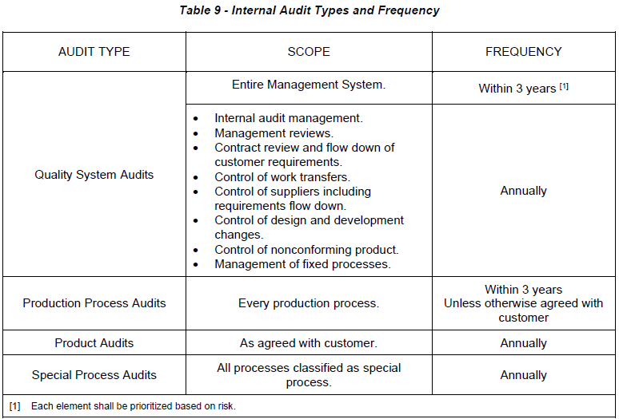
9.2.3 Internal Audit – Supplemental Requirements
The organization shall have a documented process that describes the internal audit process.
The audit plan shall include all elements within the scope of the Management System and include:
Quality System Audits.
Production Process Audits.
Product Audits.
Special Process Audits.
For default frequency for each type of Internal Audit, see Table 9.

Slide 117
9.2.3 Continued
Quality System audits shall include the review of compliance to the appropriate Industry QMS Certification standard, i.e., 9100, ISO 9001, and this standard.
The organization shall ensure that regulatory and customer specific quality system requirements are included within the audit scope, as applicable.
The Production Process Audit shall be conducted using an approved checklist, e.g., VDA6.3 checklist (2.4), or equivalent, see RM13005. Production Process audits should include samples from all standard shifts operated by the organization over the course of the audit cycle.
The Special Process audit shall be conducted annually (regardless of the Nadcap merit scheme status).
Where the Special Process is Nadcap certified then the internal audit checklist shall be the specified Nadcap checklist, based on Special Process Audit Criteria (AC), publications (2.3), formally known as “Process checklist.” If the Special Process is not Nadcap certified then the organization can use either the Nadcap checklist for that process, supported by customer specifications, or a checklist developed by the customer or the organization that fully evaluates the conformity of the process.
The frequency of audits shall be reviewed and be increased, if required, due to process changes, quality performance, or risk.

Slide 118
9.2.3 Continued
Does the organization have a documented process that describes the internal audit process?
Does the audit plan include all elements within the scope of the Management System and include:
  Quality System Audits.
    Production Process Audits.
    Product Audits.
    Special Process Audits.
For default frequency for each type of Internal Audit, see Table 9.
Do the Quality System audits include the review of compliance to the appropriate Industry QMS Certification standard, i.e., 9100, ISO 9001, and this standard?
Did the organization ensure that regulatory and customer specific quality system requirements are included within the audit scope, as applicable?
Was the Production Process Audit conducted using an approved checklist, e.g., VDA6.3 checklist (2.4), or equivalent, see RM13005? Does the Production Process audit include samples from all standard shifts operated by the organization over the course of the audit cycle?
Was the Special Process audit conducted annually (regardless of the Nadcap merit scheme status)?
If the Special Process is Nadcap certified, is the internal audit checklist the specified Nadcap checklist, based on Special Process Audit Criteria (AC), publications (2.3), formally known as “Process checklist”? If the Special Process is not Nadcap certified, did the organization use either the Nadcap checklist for that process, supported by customer specifications, or a checklist developed by the customer or the organization that fully evaluates the conformity of the process?
Were the frequency of audits reviewed and increased, if required, due to process changes, quality performance, or risk?

Slide 119
9.2.4 Audit nonconformance related to product quality – Supplemental Requirements
If the audit identifies a nonconformance impacting product conformity, the nonconformance shall be addressed, (8.7, 10.2.3).
If the audit identified a nonconformance impacting product conformity, was the nonconformance addressed, (8.7, 10.2.3)?

Slide 120
9.2.5 Annual Audit Report – Supplemental Requirements
All organizations shall prepare an Annual Audit Report to demonstrate their compliance to this standard.
The report shall include the supplier, external (e.g., certifying bodies, customers)) and internal audit analysis from the most current audit cycle/program and the audit program (supplier and internal) for the future calendar year.
The Annual Audit Report shall be submitted to the customer upon request.
Based on the results from the Organization’s Annual Audit Report the customer can apply an additional level of surveillance on the organization.
Does the organization prepare an Annual Audit Report to demonstrate their compliance to this standard?
Does the report include the supplier, external (e.g., certifying bodies, customers)) and internal audit analysis from the most current audit cycle/program and the audit program (supplier and internal) for the future calendar year?
NOTE: Regards details of Annual Audit Reports, see RM13005.
Are the Annual Audit Report submitted to the customer when requested?
Based on the results from the Organization’s Annual Audit Report, did the customer apply an additional level of surveillance on the organization?

Slide 121
9.3.2.1 Management Review Inputs – Supplemental Requirements
Management Reviews shall be conducted at least annually and consider the following performance topics:
Cost of Poor Quality (COPQ).
Manufacturing/Assembly Right First Time/First Pass Yield.
Customer scorecards (where available).
Human Factors reporting.
Were the Management Reviews conducted at least annually and did it consider the performance topics?

Slide 122
9.3.3.1 Management Review Outputs – Supplemental Requirements
The organization shall document and implement an action plan when agreed customer performance targets are not met.
Did the organization document and implement an action plan when agreed customer performance targets were not met?

Slide 123
Chapter A
10 - Improvement

Slide 124
10.2.3 Problem Solving, Containment and Mitigation – Supplemental Requirements
When a nonconforming product escapes to the customer and where the organization is required to conduct a problem investigation by the customer then the default problem solving methodology shall be the 8D Problem Solving process approach (steps D0 to D8), see RM13000. Alternative approaches may be acceptable to the customer with prior approval provided they meet the same intent.
Where suspected nonconformance is observed at any point in the product lifecycle, including design and there is customer impact, the organization shall take immediate containment action to protect the customer.
Immediate Response Actions (see RM13000 - step D0) in 8D shall be completed within 48 hours of the problem being identified unless otherwise agreed with the customer.
It is the organization’s responsibility to fully contain the escape (see RM13000 - step D3) implementing Interim Containment actions (ICA) by identifying all parts affected across the value chain. The organization shall work with key stakeholders, including the customer(s) and suppliers (if relevant) to ensure that containment is effective. The timescale for full containment being appropriate to the risk impact of the problem.
The organization shall communicate the status of the containment activity to the customer at regular intervals.
The organization having initiated containment action, shall identify and complete Root Cause Analysis, (see RM13000 - D4) and Corrective Action(s), (see RM13000 - D5) in a reasonable timescale to meet Customer requirements.
The organization shall define an implementation plan for the corrective and preventive actions required and monitor progress.

Slide 125
10.2.3 Continued
The organization shall take systemic action to prevent recurrence of this problem and other similar problems and capture the lessons learned.
The organization shall update all related DTDP(s). Relative to the root cause generation and escape points.
The organization shall update the Process Flow Diagram (PFD), Process FMEA, and Control Plan with any insights from the investigation, e.g., Process FMEA Occurrence and Detection Scores, Control Plan activities.
When the customer requires an investigation report from the organization as evidence of the problem-solving activity for a product nonconformance then it shall be provided using the AESQ 8D Summary Report, or one with an equivalent content (see RM13000).
The organization shall analyze the causes of each type of nonconformity and determine risk based prioritized improvement plans to continually improve performance (10.3.1).
The organization shall ensure that it has problem solving practitioners that are trained and competent in the use of AESQ 8D Problem Solving methodology.
The organization shall have a criteria and approach defined for recognizing and addressing Human Factors causes in investigations, e.g., Maintenance Event Decision Aid, see RM13010.

Slide 126
10.2.3 Continued
If a nonconforming product escaped to the customer and the organization was required to conduct a problem investigation by the customer, was the default problem solving methodology the 8D Problem Solving process approach (steps D0 to D8), see RM13000?
Note: Alternative approaches may be acceptable to the customer with prior approval provided they meet the same intent.
If suspected nonconformance was observed at any point in the product lifecycle, including design and there was customer impact, did the organization take immediate containment action to protect the customer?
Were Immediate Response Actions (see RM13000 - step D0) in 8D completed within 48 hours of the problem being identified unless otherwise agreed with the customer?
Note: It is the organization’s responsibility to fully contain the escape (see RM13000 - step D3) implementing Interim Containment actions (ICA) by identifying all parts affected across the value chain.
Did the organization work with key stakeholders, including the customer(s) and suppliers (if relevant) to ensure that containment was effective? The timescale for full containment being appropriate to the risk impact of the problem.
Did the organization communicate the status of the containment activity to the customer at regular intervals?
Did the organization, having initiated containment action, identify and complete Root Cause Analysis, (see RM13000 - D4) and Corrective Action(s), (see RM13000 - D5) in a reasonable timescale to meet Customer requirements?
Did the organization define an implementation plan for the corrective and preventive actions required and monitor progress?
Did the organization take systemic action to prevent recurrence of this problem and other similar problems and capture the lessons learned?
Did the organization update all related DTDP(s). Relative to the root cause generation and escape points?
Did the organization update the Process Flow Diagram (PFD), Process FMEA, and Control Plan with any insights from the investigation, e.g., Process FMEA Occurrence and Detection Scores, Control Plan activities?
If the customer required an investigation report from the organization as evidence of the problem-solving activity for a product nonconformance, was it provided using the AESQ 8D Summary Report, or one with an equivalent content (see RM13000)?
Did the organization analyze the causes of each type of nonconformity and determine risk based prioritized improvement plans to continually improve performance (10.3.1)?
Did the organization ensure that it has problem solving practitioners that are trained and competent in the use of AESQ 8D Problem Solving methodology?
NOTE: Regards details of recommended training syllabus for problem solving specialists, see RM13000.
Did the organization have a criteria and approach defined for recognizing and addressing Human Factors causes in investigations, e.g., Maintenance Event Decision Aid, see RM13010?

Slide 127
10.2.4 Customer Complaints and In-Service Failures – Supplemental Requirements
The organization shall perform analysis on customer complaints and initiate problem solving and corrective action to prevent reoccurrence.
To the extent contractually agreed between the organization and the customer, the organization shall:
Perform analysis on in-service failures of products that the organization has designed and initiate problem solving and corrective action to prevent reoccurrence.
Include analysis of any interaction of embedded software of the organization's product within the system of the customer's product.
Communicate the results of analysis to the customer and within the organization.
Did the organization perform analysis on customer complaints and initiate problem solving and corrective action to prevent reoccurrence?
To the extent contractually agreed between the organization and the customer, did the organization:
  Perform analysis on in-service failures of products that the organization has designed and initiate problem solving and corrective action to prevent reoccurrence?
  Include analysis of any interaction of embedded software of the organization's product within the system of the customer’s product?
  Communicate the results of analysis to the customer and within the organization

Slide 128
10.3.1 Continual Improvement – Supplemental Requirements
The organization shall have a systematic approach to continual improvement, including:
Identification of the appropriate methodology used, objectives, measurement, effectiveness, and documented information.
A manufacturing process improvement action plan with emphasis on the reduction of process variation and waste, see RM13006.
Use of risk evaluation processes to identify potential areas of concern. This may be derived from such tools as FMEA and Business Continuity Risk Registers.
Improvement methodologies can include approaches such as LEAN, 6 Sigma, 5 ‘S’, etc. The organization should have a defined improvement process and have practitioners trained to an appropriate standard.
Does the organization have a systematic approach to continual improvement, including:
  Identification of the appropriate methodology used, objectives, measurement, effectiveness, and documented information.
  A manufacturing process improvement action plan with emphasis on the reduction of process variation and waste, see RM13006.
  Use of risk evaluation processes to identify potential areas of concern. This may be derived from such tools as FMEA and Business Continuity Risk Registers?
NOTE: Continual improvement is implemented once manufacturing processes are statistically stable and capable or when product characteristics are predictable and meet customer requirements.
Improvement methodologies can include approaches such as LEAN, 6 Sigma, 5 ‘S’, etc. Does the organization have a defined improvement process and have practitioners trained to an appropriate standard?

Slide 129
Chapter B
13 – Scope

Slide 130
13.3 Scope (APQP) – Supplemental Requirements
All or some phases of APQP are applicable to a:
New product design or change to design.
New or change to production location or source producing the product.
New process or process change unless process change is negligible.
Change of tooling that is not Specific to Process and an equivalent.
  Change that does not impact process stages that control or monitor KCs.
  Change that does not require a change to inspection/test methods.
  Change that does not introduce additional or alternative processing.
All paragraphs applicable to PPAP apply, unless otherwise stated.
All or some phases of APQP are applicable to a:
  New product design or change to design.
  New or change to production location or source producing the product.
  New process or process change unless process change is negligible.
NOTE: Examples of negligible process change include:
Change that does not have the potential to impact the performance of the process (Quality, cycle time).
Change of tooling that is not Specific to Process and an equivalent.
Change that does not impact process stages that control or monitor KCs.
Change that does not require a change to inspection/test methods.
Change that does not introduce additional or alternative processing.
All paragraphs applicable to PPAP apply, unless otherwise stated

Slide 131
Chapter B
16 – ADVANCED PRODUCT QUALITY PLANNING (APQP) REQUIREMENTS

Slide 132
16.1.6 APQP – Supplemental Requirements
The organization shall:
Establish a documented procedure, to comply with AESQ APQP and PPAP requirements (16.1.1.).
Apply Supply Chain Risk Management process (18) and provide result, unless otherwise specified by the customer, (16.1.5).
Has the organization:
  Established a documented procedure, to comply with AESQ APQP and PPAP requirements (16.1.1.)?
NOTE: AESQ APQP and PPAP Flow (see, Figure 3) provides a model for an organization’s procedure?
  Applied Supply Chain Risk Management process (18) and provide results, unless otherwise specified by the customer, (16.1.5)?

Slide 133
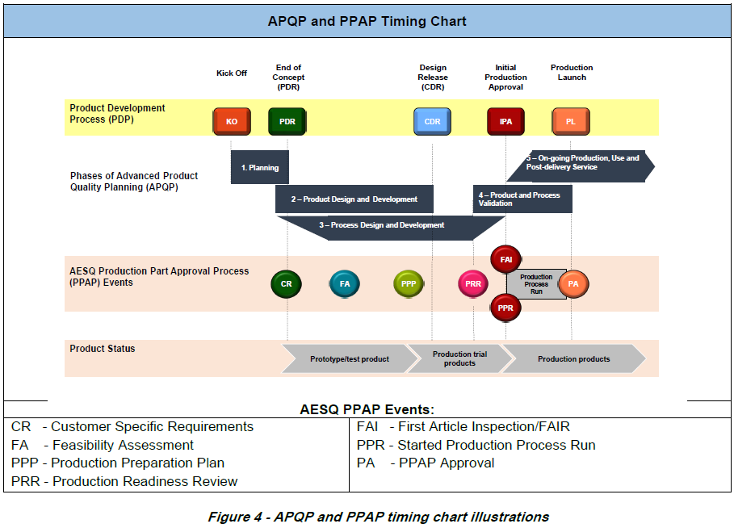
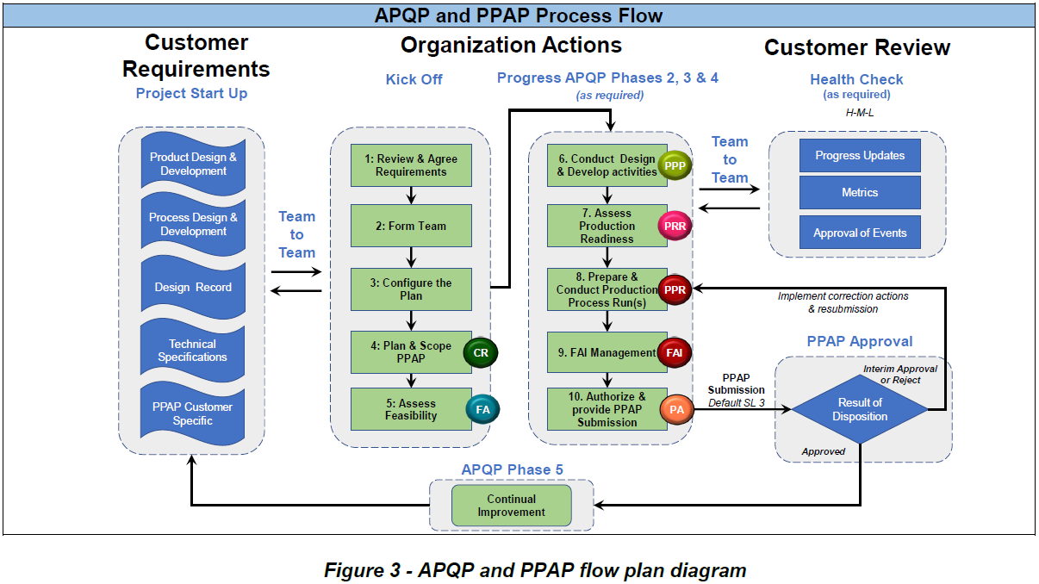
16.1.7 APQP and PPAP Flow and APQP and PPAP Timing Plan illustrations – Supplemental Requirements
The APQP and PPAP Flow (see Figure 3) describes a customer/supplier management process for any product and APQP and PPAP. This is harmonized with 9145, using - AESQ PPAP Events, (a development of those found within 9145) and APQP and PPAP Timing (see Figure 4) which develops the conceptual Illustration found within 9145.
A description of PPAP events are defined in Table 10, see RM13145, which provides detail on both the APQP and PPAP Flow and APQP and PPAP Timing Plan.

Slide 134
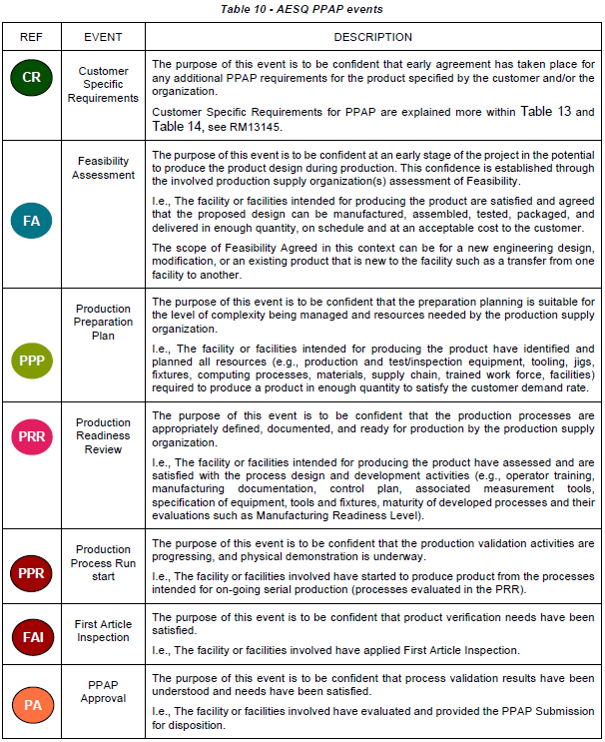
16.1.7 Continued

Slide 135
16.1.7 Continued
The APQP and PPAP Flow describes a customer/supplier management process for any product and APQP and PPAP. This is harmonized with 9145, using - AESQ PPAP Events, (a development of those found within 9145) and APQP and PPAP Timing which develops the conceptual Illustration found within 9145.
Note: A description of PPAP events are defined in Table 10, see RM13145, which provides detail on both the APQP and PPAP Flow and APQP and PPAP Timing Plan.

Slide 136
16.2.1 Advanced Product Quality Planning Project Management – Supplemental Requirements
The organization shall:
Account for Supply Chain Risk Management Process (18) when developing and managing the plan.
Develop metrics that monitor progress and satisfaction of APQP and PPAP Events, (16.2).
Does the organization:
  Account for Supply Chain Risk Management Process (18) when developing and managing the plan?
  Develop metrics that monitor progress and satisfaction of APQP and PPAP Events, (16.2)?

Slide 137
16.3.5 Phase 1 – Planning – Supplemental Requirements
The organization shall:
Account for Supply Chain Risk Management Process (18) when developing Project Plan.
Does the organization:
  Account for Supply Chain Risk Management Process (18) when developing s Project Plan?

Slide 138
16.4.7 Phase 2 – Product Design and Development – Supplemental Requirements
The organization shall:
Use Design FMEA, to satisfy Design Risk Analysis, see RM13004.
Does the organization:
  Use Design FMEA, to satisfy Design Risk Analysis?
Note: See RM13004 - Further Risk Analysis may be needed to assess safety and criticality.

Slide 139
16.5.10 Phase 3 – Process Design and Development – Supplemental Requirements
The organization shall:
Conduct Process Flow Diagrams (PFDs), Process FMEA and Control Plans, (NOTE 1), see RM13004. These shall be completed for a specific part number. A Family or Group of parts approach is not allowed unless approved by the customer.
Account for Supply Chain Risk Management Process (18), when developing Production Preparation Plan.
Include all requirements of the Design Record when developing the inspection/test plan (Workstation documentation) and apply 100% inspection unless approval is obtained by the organization for an alternate inspection frequency (9.1.1.2), see RM13002.
Have developed a Prelaunch Control Plan, (18). when product verification, process validation and/or data capture activities are to take place.
Develop the associated MSA Plan, (NOTE 2), see RM13003 and RM13145.
Include the requirements of this paragraph when conducting a Production Readiness Review (PRR).

Slide 140
16.5.10 Continued
Does the organization:
  Conduct Process Flow Diagrams (PFDs), Process FMEA and Control Plans,
Note: See RM13004. These shall be completed for a specific part number. A Family or Group of parts approach is not allowed unless approved by the customer.
  Account for Supply Chain Risk Management Process (18), when developing Production Preparation Plan.
  Include all requirements of the Design Record when developing the inspection/test plan (Workstation documentation) and apply 100% inspection unless approval is obtained by the organization for an alternate inspection frequency (9.1.1.2),
Note: See RM13002
  Develop a Prelaunch Control Plan, (18). when product verification, process validation and/or data capture activities are to take place.
  Develop the associated MSA Plan, (NOTE 2), see RM13003 and RM13145.
  Include the requirements of this paragraph when conducting a Production Readiness Review (PRR).
Note: This is an element of the PPAP file and may be required for the Submission (Submission Levels).
Note: MSA Plan documents the planned actives that are to be carried out during APQP Phase 4 (Product and Production Validation) to satisfy MSA requirements for the product.

Slide 141
16.6.9 Phase 4 – Product and Process Validation – Supplemental Requirements
The organization shall:
Conduct MSA, see RM13003.
Using product from the Production Process Run, see Table 13, conduct Initial manufacturing performance studies, as part of the Capacity verification and determine the Dimensional/Nondimensional results, see RM13145.
The minimum acceptable Cpk/Ppk for KCs is 1.33 although some customers may require higher thresholds and broader scope beyond just KCs.
Have developed a Production Control Plan, (18), (NOTE).
Conduct FAI in accordance with 9102, (NOTE).
Complete the PPAP submission in accordance with the AESQ PPAP requirements, (see Table 13).
Does the organization: Conduct MSA?
Note: See RM13003
  Using product from the Production Process Run, (see Table 13), conduct Initial manufacturing performance studies, as part of the Capacity verification and determine the Dimensional/Nondimensional results, see RM13145.
Note: The minimum acceptable Cpk/Ppk for KCs is 1.33 although some customers may require higher thresholds and broader scope beyond just KCs.
  Developed a Production Control Plan, (18)?
  Conduct FAI in accordance with 9102?
  Complete the PPAP submission in accordance with the AESQ PPAP requirements, (see Table 13). NOTE: This is an element of the PPAP file and may be required for the Submission (Submission Levels)

Slide 142
Chapter B
17 – PRODUCTION PART APPROVAL PROCESS REQUIREMENTS

Slide 143
17.1.1 Process Requirements for Production Part Approval Process – Supplemental Requirements
The organization shall:
Define the person(s) responsible for PPAP approval (PPAP Coordinators) and their qualification, including customer qualifications and the use of Customer Authorized Representatives when specified by the customer.
Develop the PPAP File and PPAP Submission for the product(s) in accordance with, Submission/Retention levels, see Table 11, AESQ PPAP Elements Requirement, see Table 13, and Customer Specific Requirements, see Table 14.
Provide the PPAP submission in accordance with Submission Level 3, see Table 11, as the default unless otherwise specified by the customer.
For Submission/Retention Levels, see Table 11, this defines Submission, Witness, and Retention requirements associated to each submission level. In all instances, supporting data for the PPAP elements shall be gathered regardless of the submission level and held within the PPAP File. Applicability is mandated through this AESQ APQP and PPAP standard and/or customer requirements. For typical use of PPAP Elements for various types of situations, see Table 12.

Slide 144
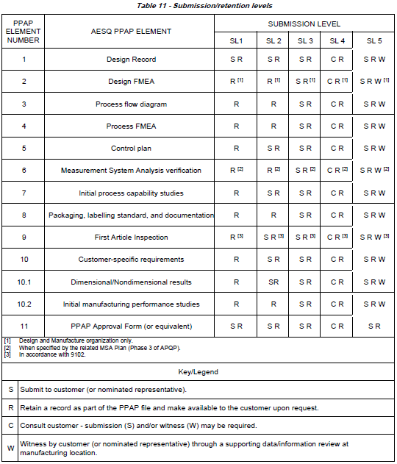
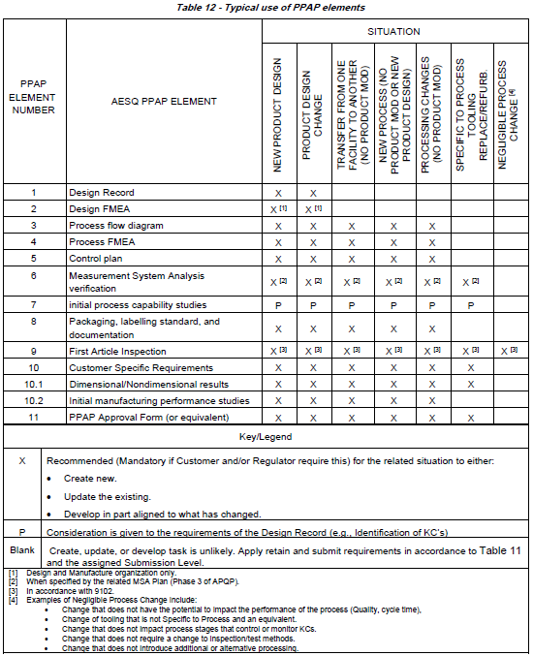
17.1.1 Continued

Slide 145
17.1.1 Continued
Does the organization:
  Define the person(s) responsible for PPAP approval (PPAP Coordinators) and their qualification, including customer qualifications and the use of Customer Authorized Representatives when specified by the customer?
Note: Regards details of role profile and recommended qualification requirements for organization PPAP coordinator’s and Customer Authorized Representatives, see RM13145.
  Develop the PPAP File and PPAP Submission for the product(s) in accordance with, Submission/Retention levels, see Table 11, AESQ PPAP Elements Requirement? See Table 13, and Customer Specific Requirements? See Table 14.
  Provide the PPAP submission in accordance with Submission Level 3? See Table 11, as the default unless otherwise specified by the customer?
Note: For Submission/Retention Levels, see Table 11, this defines Submission, Witness, and Retention requirements associated to each submission level.
  Was the supporting data for the PPAP elements gathered regardless of the submission level and held within the PPAP File?
  Was the applicability mandated through this AESQ APQP and PPAP standard and/or customer requirements?
Note: For typical use of PPAP Elements for various types of situations, see Table 12.

Slide 146
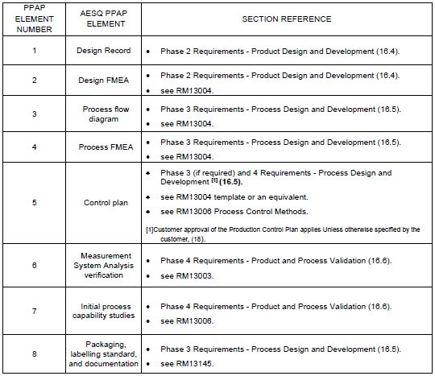
17.2.3 Production Part Approval Process File and Submission – Supplemental Requirements
The organization shall:
Meet all specific requirements of the AESQ PPAP Elements Requirements, see Table 13.
Ensure that the PPAP Coordinator (17.1.1) for the product has reviewed the PPAP Submission and authorized the PPAP Approval Form (or equivalent) on behalf of their organization.

Slide 147
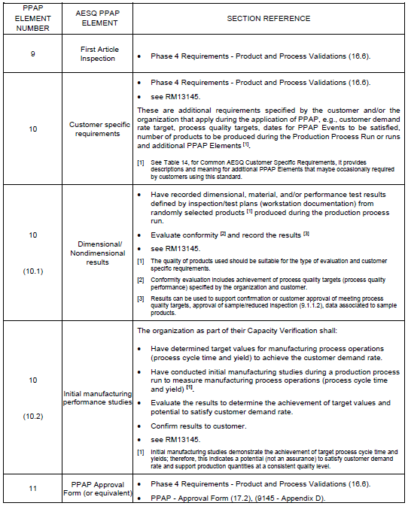
17.2.3 Continued

Slide 148
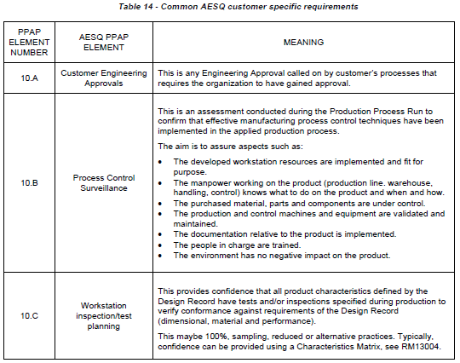
17.2.3 Continued
The common specific customer requirements, AESQ PPAP Element 10 (Table 13), can be expanded, see Table 14, with additional PPAP elements descriptions that may be occasionally required by customers.
These additional elements may be individually specified by a customer on occasion when determined as beneficial to the validation of the related product and/or process. This provides a common understanding to users of this standard.

Slide 149
17.2.3 Continued
Does the organization:
  Meet all specific requirements of the AESQ PPAP Elements Requirements, see Table 13.
  Ensure that the PPAP Coordinator (17.1.1) for the product has reviewed the PPAP Submission and authorized the PPAP Approval Form (or equivalent) on behalf of their organization.

Slide 150
Chapter B
18 – AESQ SUPPLY CHAIN RISK MANAGEMENT PROCESS – SUPPLEMENTAL REQUIREMENTS

Slide 151
18 AESQ SUPPLY CHAIN RISK MANAGEMENT PROCESS – SUPPLEMENTAL REQUIREMENTS
This provides a standardized approach to Project based APQP Assurance in association with AESQ APQP and PPAP. AESQ Supply Chain Risk Management Process, see RM13145, is a risk-based assurance method that operates top down with respect to the level of application in the supply chain and during the APQP Project, e.g., more assurance on those organizations and/or products that are high risk or provide high-risk products (complex, high severity failure ranking on features, material availability, unique and/or difficult, etc.).
The assurance practices deployed for Supply Chain Risk Management process shall include:
APQP Assurance Actions aligned to ratings, e.g., H-M-L rating, scopes what is expected between the organization and their suppliers and customers (AESQ APQP Assurance Framework), see Table 15.
Special attention during the project to the following for high risk products and/or organizations:
  Sourcing Strategy and plan, e.g., Additional sources.
  Stocking policy, e.g., Pull forward inventory, increase levels for periods of time.
  Supplier Development strategy, e.g., Technology development, capability improvements of suppliers.
  Special actions, e.g., Financial, Third Party Inspection.
Table 15 provides a minimum standard APQP Assurance Framework in association with Supply Chain Risk Management.

Slide 152
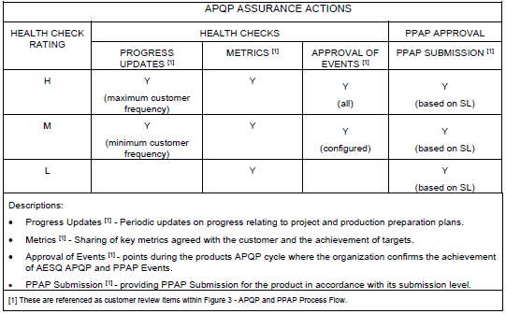
18 Continued

Slide 153
18 Continued
Does the assurance practices deployed for Supply Chain Risk Management process include:
  APQP Assurance Actions aligned to ratings, e.g., H-M-L rating, scopes what is expected between the organization and their suppliers and customers (AESQ APQP Assurance Framework)?
Note: see Table 15.
  Special attention during the project to the following for high-risk products and/or organizations:
    Sourcing Strategy and plan, e.g., Additional sources?
    Stocking policy, e.g., Pull forward inventory, increase levels for periods of time?
    Supplier Development strategy, e.g.?
  Technology development, capability improvements of suppliers. o Special actions, e.g., Financial, Third-Party Inspection?
Note: Table 15 provides a minimum standard APQP Assurance Framework in association with Supply Chain Risk Management.

Slide 154
Chapter B
19 – CONTROL PLAN – SUPPLEMENTAL REQUIREMENTS

Slide 155
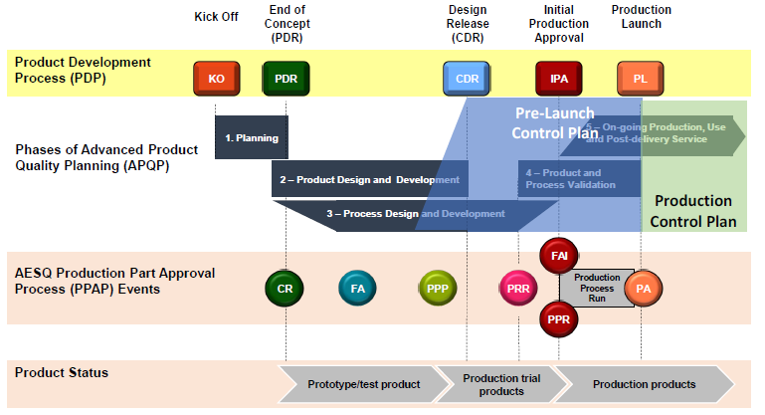
19 CONTROL PLAN – SUPPLEMENTAL REQUIREMENTS
Control plans are written descriptions of the systems for controlling parts and processes (as described within 9145 - Appendix C). Two distinct phases of the control plan can be applied (9145 - Appendix C, C1 Phases of the Control Plan):
Prelaunch – A description of the dimensional and nondimensional measurements, the timing of this is illustrated in Figure 5.
Production – A comprehensive documentation of product/process characteristics, process controls, tests, and measurement systems that can occur during postproduction launch.

Slide 156
19 Continued
The organization shall:
Have a process for reviewing and updating the control plan (NOTE 1), throughout the APQP Phases of application and when changes occur (e.g., affecting product, production process, measurement, logistics, supply sources, Process FMEA). This includes Unless otherwise specified by the customer, the approval of the Production Control Plan (NOTE 2), as part of the PPAP Submission.
Does the organization:
  Have a process for reviewing and updating the control plan (NOTE 1), throughout the APQP Phases of application and when changes occur (e.g., affecting product, production process, measurement, logistics, supply sources, Process FMEA). This includes Unless otherwise specified by the customer, the approval of the Production Control Plan (NOTE 2), as part of the PPAP Submission.
NOTE 1: The control plan is not equivalent to the process control document defined in 9103.
NOTE 2: When customer approval applies and Prelaunch Control Plan is in use, the Pre-launch and Production Control Plan for approval are used for PPAP Submission.

Slide 157
19.1 Prelaunch Control Plan – Supplemental Requirements
When developing the Prelaunch Control Plan, the organization shall include all dimensional and nondimensional measurements that are required to occur. This includes enhancements that limit the potential for nonconformances and the validation of the production process. Examples of enhancements are:
Additional Process Controls (see RM13006) to those intended for regular/ongoing production which have been determined from knowledge (lessons learnt, identified within standards, etc.), or through studies of the process such as Design of Experiments (DOE).
More occurrence of the intended 100% Test/Inspection, i.e., in-process and final check points.
Robust statistical evaluations (see RM13006) to support reduce/sample inspection approval, determining capability of KCs (initial process capability studies).
Data collection to support evaluation of process quality performance such as Defects per Unit (DPU).
Audits such as Process Control Surveillance, see Table 14.
Identification of Error-proofing device(s) for confirmation of Effectiveness.
Product Verification such as FAI (see RM13102).

Slide 158
19.1 Continued
When developing the Prelaunch Control Plan, does the organization include all dimensional and nondimensional measurements that are required to occur?
This includes enhancements that limit the potential for nonconformances and the validation of the production process. Examples of enhancements are:
  Additional Process Controls (see RM13006) to those intended for regular/ongoing production which have been determined from knowledge (lessons learnt, identified within standards, etc.), or through studies of the process such as Design of Experiments (DOE).
  More occurrence of the intended 100% Test/Inspection, i.e., in-process and final check points.
  Robust statistical evaluations (see RM13006) to support reduce/sample inspection approval, determining capability of KCs (initial process capability studies).
  Data collection to support evaluation of process quality performance such as Defects per Unit (DPU).
  Audits such as Process Control Surveillance, see Table 14.
  Identification of Error-proofing device(s) for confirmation of effectiveness.
  Product Verification such as FAI (see RM13102).

Slide 159
Chapter C
20 – Overview: Supplement Requirements

Slide 160
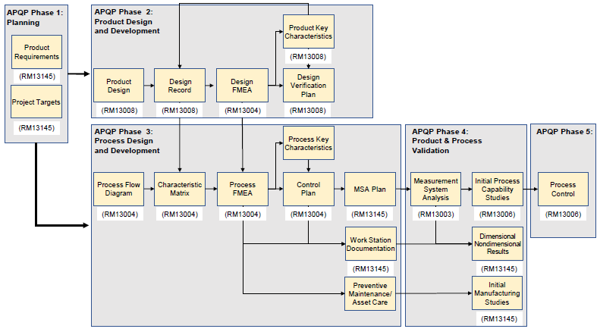
20.1 Key Quality Planning Tools
There are several key Quality Planning tools that are required to support the APQP and PPAP process. These Quality Planning Tools are linked as shown in Figure 6.

Slide 161
20.1 Continued
The Quality Planning Tools shall be applied at a part number level, unless otherwise directed by the customer.
These Quality Planning Tools shall be reviewed and updated when there are changes to the product, manufacturing and inspection process or the source of manufacture.
The organization shall ensure that any learning is fed back into the relevant documents and captured to ensure that they reflect the current knowledge, e.g., product quality escapes, inspection data, root cause and corrective action learning, read across from other products.
Documents shall be linked to provide an easy read across when changes occur. Operation numbering and sequencing detailed on the PFD being consistent throughout all the document produced.
Does the organization have applied knowledge and can demonstrate practical application of the Key Quality Planning Tools identified in figure 6 to support the APQP & PPAP processes?

Slide 162
21.1 Design FMEA
Design Risk Analysis (DRA) within 9145 shall be conducted using Design FMEA, see RM13004
Does the organization have evidence that a Design FMEA was applied at any system level and assists in the creation of a technical specification which delivers the functional requirements?
Does the organization have access to and working knowledge of RM13004? Does the organization apply this to execute Design Risk Analysis?

Slide 163
21.2 Product Key Characteristics
The organization shall comply with customer requirements for the identification of Product KCs.
Does the organization have documentation of compliance with customer requirements for the identification of Product KCs?

Slide 164
21.3 Process Flow Diagrams (PFDs)
The organization shall document the Process Flow used to manufacture the particular part number using the approved methodology, see RM13004.
The PFD shall be sufficiently detailed in order to clearly and completely describe the process required to receive material, manufacture, inspect, test, protect, store, and ship conforming product.
The organization shall use one of the defined PFD templates, see RM13004, or one with equivalent content. Any deviation to this being approved by the customer.
Can the organization provide documented Process Flow Diagrams that clearly and completely describe the process required to receive material, manufacture, inspect, test, protect, store, and ship conforming product?

Slide 165
21.4 Process FMEA
The organization shall carry out Process FMEA, see RM13004, unless otherwise agreed with the customer.
The organization shall use the Process FMEA methodology to identify additional product KCs and/or relevant process KCs, in addition to those defined in the Design Records.
The Process FMEA shall be completed for a specific Part Number and include all operations identified in the PFD, from Goods Inwards through to Dispatch.
Details of steps within each operation shall be considered and included if they are intended to, or have the potential to, transform the product (intentionally or unintentionally).
Does the organization conduct Process FMEAs, unless otherwise agreed to and documented with the customer? Does the organization use the Process FMEA methodology to identify additional product KCs and/or relevant process KCs, in addition to those defined in the Design Records? Is the Process FMEA completed for a specific Part Number and include all operations identified in the PFD, from Goods Inwards through to Dispatch. Doe this include details of steps within each operation that are intended to, or have the potential to, transform the product (intentionally or unintentionally).

Slide 166
21.4 Continued
Does the organization document recommended actions needed to prevent or mitigate risks in the Process FMEA?
Is the organization using the Process FEMA Template, Ranking Criteria, found in 13004? If not has it been approved by the customer? Does the Scope of the Process FMEA include product characteristics defined by the Design drawings and specifications? If there is a reduced scope of application is there a documented rationale for the reduced scope for traceability purposes? Are Failure Modes documented in the Process FMEA in terms that relate them to Design Records?
Does the organization properly use the RPN to establish the priority of risk mitigation actions:
  Does the organization use the RPN thresholds to consider each risk independently?
  In addition to reviewing risks with a high RPN, does the organization review risks with individually high severity, occurrence, or detection rankings in order to mitigate product quality escapes?

Slide 167
21.5 Process Key Characteristics
The Process FMEA shall be used to identify Process and Product KCs through RPN or Severity x Occurrence as defined by customer requirement and/or organizational policy, see RM13004.
Both product and process KCs shall be recorded in the Process FMEA (i.e., by using the “Classification” column in the Process FMEA template).
Does the organization use the Process FMEA to identify Process and Product KCs through RPN or Severity x Occurrence as defined by customer requirement and/or organizational policy per RM13004?

Slide 168
21.6 Production Control Plan
The Control Plan shall be prepared and applied as early as possible during process development.
The Control Plan shall comply with the following:
List the product and process characteristics to be monitored, during the manufacturing process, along with any required control methods.
Control methods typically include but are not limited to:
Variable or attribute Statistical Process Control and/or inspection, mistake-proofing (automated and nonautomated), life usage control, first piece check of each setup, test piece evaluation and sampling plans (where these are acceptable to the customer).
Include and indicate all product and process KCs and CIs defined by the customer and the organization.
Specify the reaction plan to be invoked when the process becomes unstable or a failure occurs.
Controls and reaction plans specified within the Control Plan shall be documented within a Work Instruction and/or Inspection Plan.
The organization shall use a Control Plan template, see RM13004, or one with equivalent content. Any deviation to this being approved by the customer.

Slide 169
21.6 Continued
Has the organization used the guidance provided in RM13004 to develop and document their control plan?
Does the organization use the Control Plan template from RM13004, or one with equivalent approved by the customer?
Does the organizations Control Plan place emphasis on pro-active controls at the point of manufacture, employ prevention rather than detection and verify output at the earliest possible operation/step within the process?
Does the organizations’ control plan:
  List the product and process characteristics to be monitored, during the manufacturing process, along with any required control methods e.g. variable or attribute Statistical Process Control and/or inspection, mistake-proofing (automated and nonautomated), life usage control, first piece check of each setup, test piece evaluation and sampling plans?
  Include and indicate all product and process KCs and CIs defined by the customer and the organization.
  Specify the reaction plan to be invoked when the process becomes unstable or a failure occurs and are controls and reaction plans specified within the Control Plan documented in a Work Instruction and/or Inspection Plan.

Slide 170
21.7 Measurement Systems Analysis (MSA)
The requirements for MSA are to be as defined in 7.1.5, see RM13003.
Does the organizations MSA meet the requirements set forth in 7.1.5?
Does the organization have access to and working knowledge of RM13003?

Slide 171
21.8 Initial Capability Studies
The requirements for Initial Process Capability Studies are defined in 17.1.1, Table 11, and Table 12, see RM13006.
Does the organization have access to and working knowledge of RM13003 and follow the requirements for Initial Process Capability Studies defined in 17.1.1, Table 11, and Table 12?

Slide 172
PRI Registrar Offering

Slide 173
PRI Registrar Services
Pre-Assessment gap analysis audit to help client identify gaps against the AS13100 requirements utilizing the AESQ audit checklist
  The deliverable is the completed audit checklist with any noted gaps.
Conformity Audit against the AS13100 requirements utilizing the AESQ checklist with PRI modifications
  The deliverable is the completed audit checklist with any noted findings and narrative

Slide 174
Audit Checklist

Slide 175
AESQ Audit Checklist
Audits will be conducted using the AESQ developed checklist
Auditors will complete the checklist and provide (upload into RMS) as an output of the audit.
PRI has added NCR and narrative content for auditors to complete
Please open the checklist and follow along with this training.

Slide 176
RMS Audits

Slide 177
RMS Audit Process
AS13100 Audits will be processed in RMS much like current audits but with limited steps. Activities such as NCR closure, expert review, and certificate issuance will not apply.
Audit scheduled in RMS
Audit checklist uploaded in RMS
Expense module in RMS

Slide 178



AS13100
Auditor Training Materials
January 2022

